Slide 1
Connecting Research Ideas to Methodological Choices
Samantha Anderson
CARMA PhD Prep Panel

Slide 2

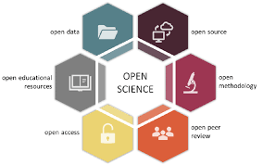
From crisis to science
The replication crisis
Learning from replication woes
Statistical and research rigor
Increased transparency
Focus on study design
Rigor involves aligning thoughtful questions with key design and analysis choices
Design
Question
Analysis

Slide 3
Pitfalls of choosing model first
Common thinking
Choosing question to fit the desired analysis
Disconnect between intent of the question and the analysis
Theoretical background limited, vague
Question itself not moving knowledge forward
May complicate replicability and lead to less interpretable research literatures
Mediation / moderation example
“I want to use this cool new analysis”
“Gotta use these variables in a novel way”
“I think these variables are related”

Slide 4
Tips for optimal alignment
First, develop the question
What do you want to know? Why is it important?
The “so what” test
Draw from past literature but do your own thinking too!
Second, consider the research design
Sampling: Who should you recruit? When, where?
Type of design: Experimental? Observational? Factorial?
Sample size planning for power or precision linked to question
Third, outline the analysis options
How will you use a model to link data to question?
Sometimes, simple is best!
Consider effectiveness of alternatives & how used in previous research

Slide 5
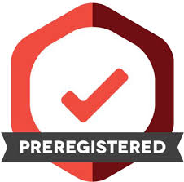
Preregistration as a facilitator
Developing design and analysis plan a priori
(Usually) before collecting data
Some justifiable changes allowed
Templates on Open Science Framework
Benefits for optimal alignment of research question and design/analysis
Shifts workload to the front-end of the process
Allows the question – not the results - to influence decisions
Promotes clarity in the research question itself, design and analysis choices in pursuit of the answer, and hypotheses

