Slide 1


An Abductive Approach to Qualitative Research
Stine Grodal
Northeastern University
Anders Dahl Krabbe
Copenhagen Business School
Micah Rajunov
University of Alberta

Slide 2
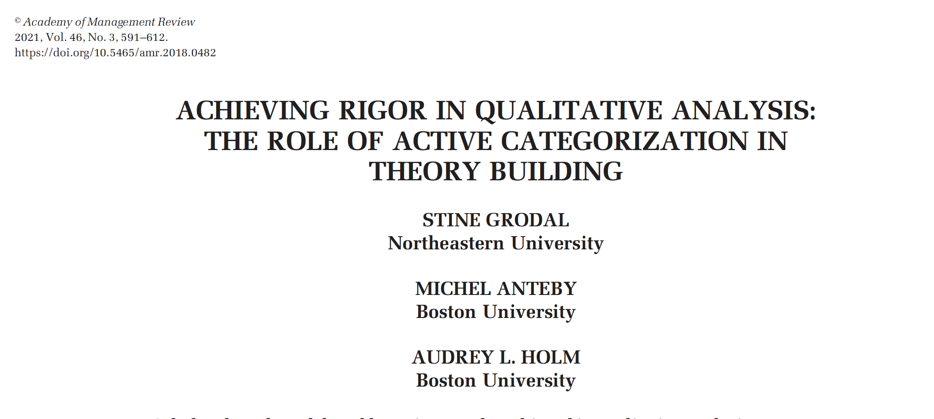
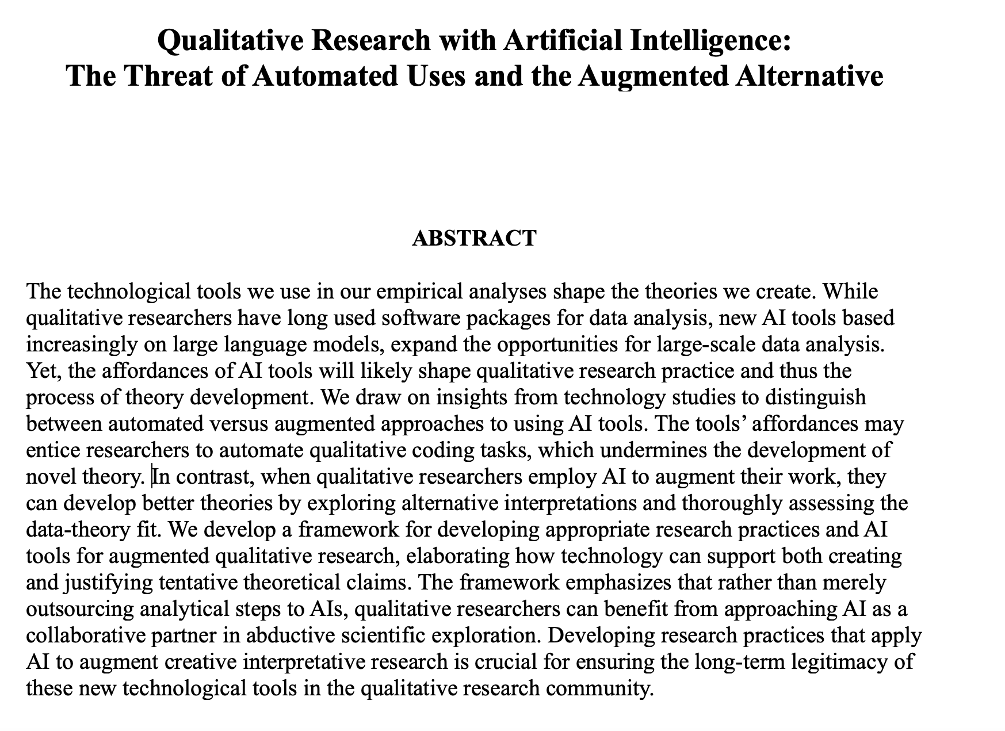
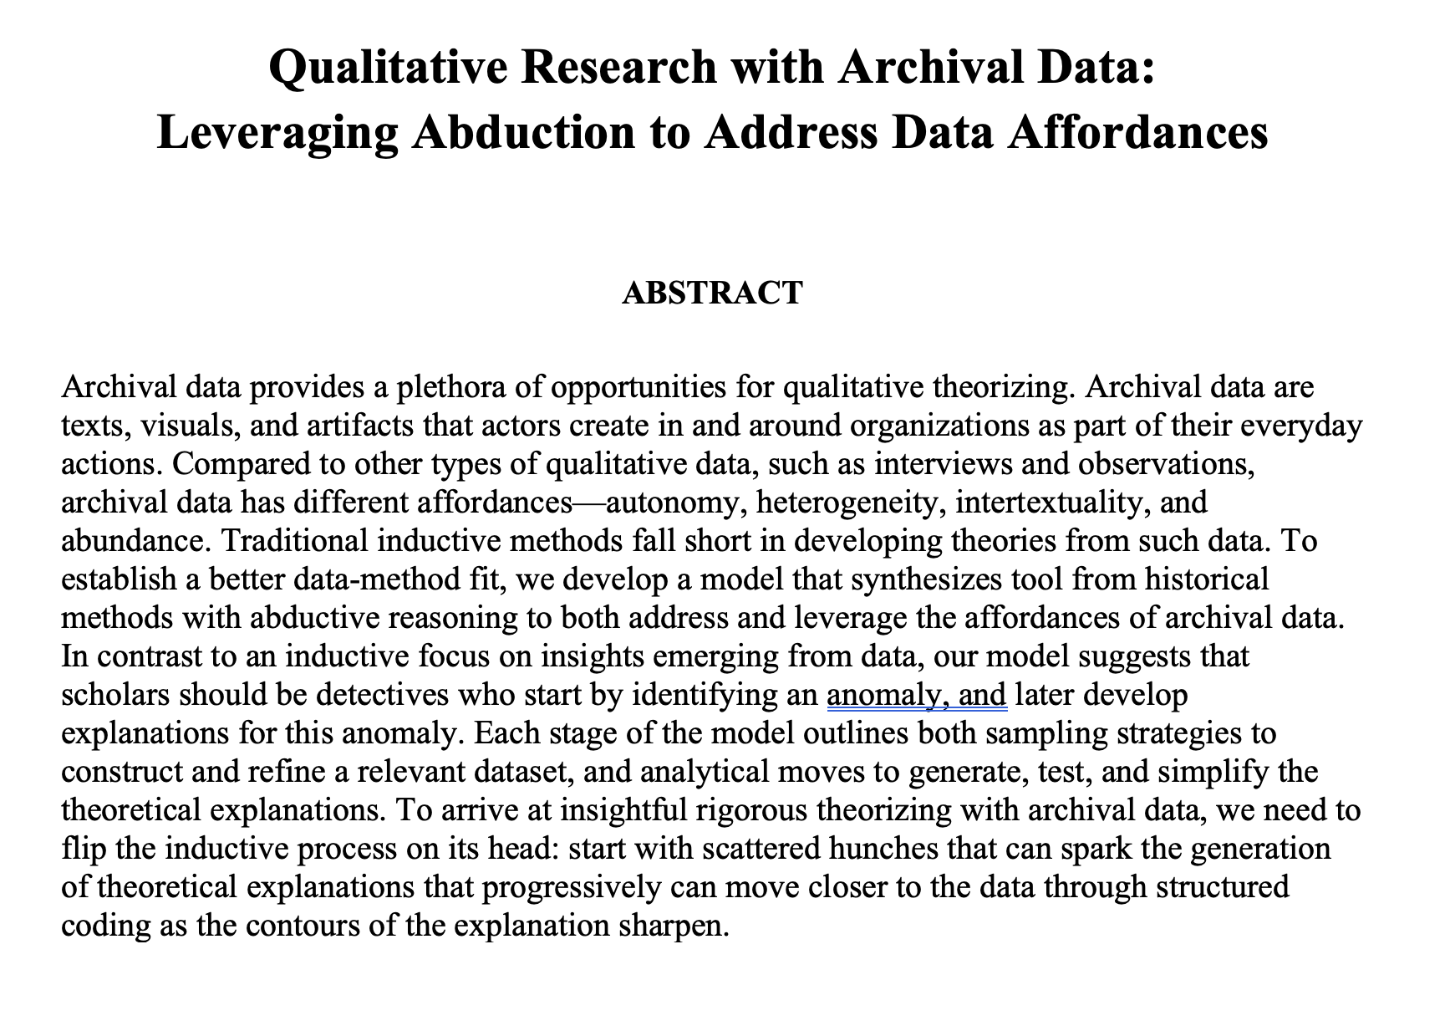
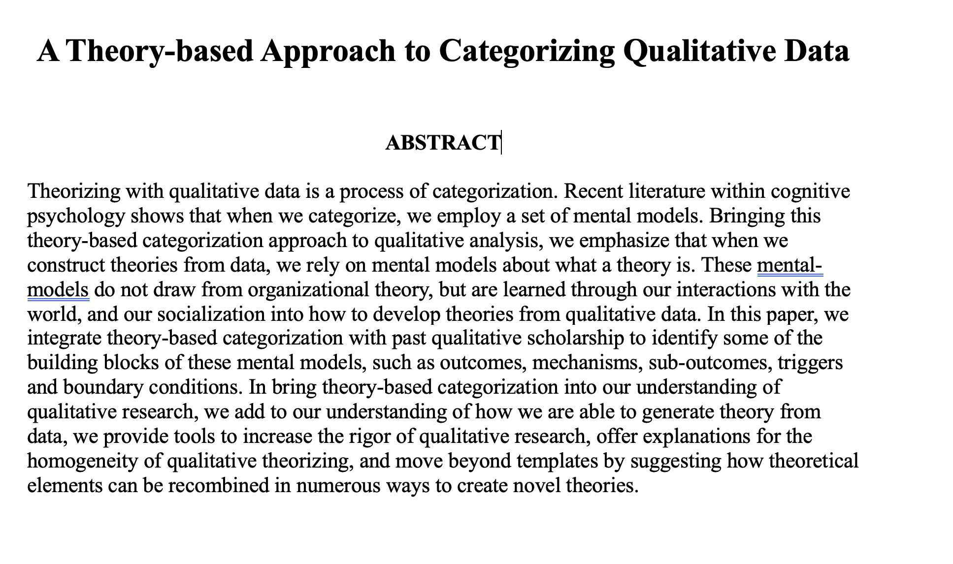
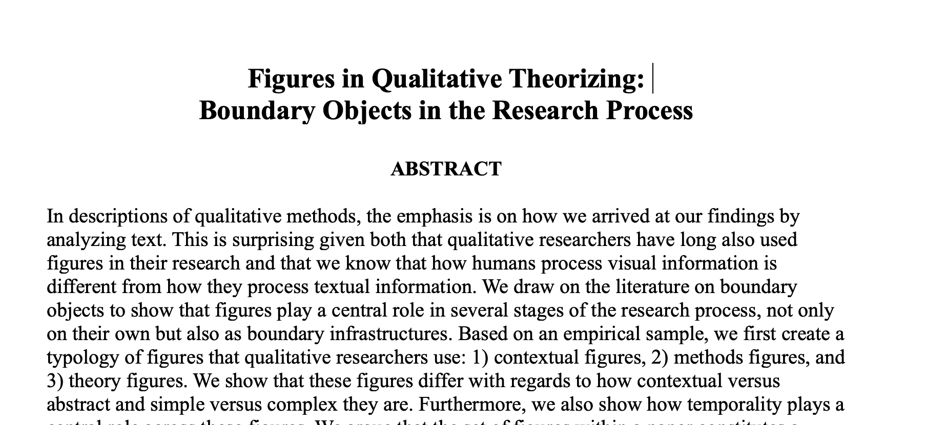

Slide 3
Induction
Most qualitative researchers refer to their style of theorizing as ”inductive” (Eisenhardt, 1989)
This has become a taken-for-granted expression, which was initiated by the founders of grounded theory (Glaser and Strauss, 1967)
When the word was created, it was meant as a contrast to ”deduction” and the quantitative testing of hypotheses, which was the dominant research paradigm at the time
In management induction is often used to refer to the creation of categories through aggregation of empirical observations (Ketokivi & Mantere, 2010)

Slide 4
Principles of Inductive research
A longstanding tradition in philosophy has emphasized how knowledge can be gained through induction (Bacon, 1620)
The principles of induction which have been most important for qualitative theory building are the following :
There should be minimal interference from prior theory (Glaser & Strauss, 1967; Mantere and Ketokivi, 2013)
Data observations are consolidated through continuous aggregation (Gioia et al., 2013; Strauss & Corbin, 1990; Langley, 1999)
Data should be sampled and analyzed until its theoretical content is exhausted (Glaser & Strauss, 1967; Strauss & Corbin, 1994; Charmaz, 2006; Tight, 2024).

Slide 5
Induction
Overarching categories
Second order categories
First order categories

Slide 6
“A theory is a statement of relations among concepts within a set of boundary assumptions and constraints” Bacharach, 1989, p. 497 Theory “must be designed to highlight relationships, connections, and interdependencies in the phenomenon of interest” Weick, 1989, p. 517
What is a theory?

Slide 7
Induction: The problem
Overarching categories
Second order categories
First order categories
Induction is not focused on explaining the interrelationship between constructs

Slide 8
Induction: The problem
Not focused on developing explanations
Not focused on identifying novelty
Does no apply equally well to all kinds of theorizing
Affordances: Difficult to use induction when the data is heterogeneous and abundant

Slide 9
Data-method fit: The failure of induction
The features of induction affordances creates challenges when scholars apply core inductive principles
Theory should be derived exclusively from empirical observation (Glaser &Strauss, 1967)
Data observations are consolidated through continuous aggregation (Gioia, Corley, & Hamilton, 2013)
Data should be sampled and analyzed until its empirical content is exhausted (Charmaz, 2006; Glaser & Strauss, 1967; Miles & Huberman, 1994)
When applied to large heterogeneous data sets these inductive principles generate an endless analysis of data, which is irrelevant to the research question.
This renders inductive research unpractical for archival research.

Slide 10
 | First principle There should be minimal interference from prior theory | Second principle Data observations are consolidated through continuous aggregation | Third principle Data should be sampled and analyzed until its theoretical content is exhausted
Heterogeneity | The lack of prior theory obscures potential compatibility in the data. The analysis is protracted because coding heterogeneous data without theoretical guidance generates too many codes. | The heterogeneity of the data stifles continuous aggregation as different elements of the data are incompatible. | Due to the heterogeneity of the data researchers continue to encounter new themes in the data. Sampling and analytical saturation is never reached and therefore protracted.
Abundance | In the absence of theoretical guidance, the researcher is confronted with protracted empirical choices about which data to sample and how to code it. | Due to the abundance of data the process of aggregation is protracted. Furthermore, small variations in the themes in abundant data, creates challenges around incompatibility. | The theoretical content is never exhausted because there is so much data to analyze, i.e. the process is protracted

Slide 11

A better method?
To find a better method, we need:
To compensate for the guidance challenge, we need an approach that is focused around an analytical and theoretical goal.
To mitigate the irrelevant data challenge, we need to sample and analyze intentionally for theoretical relevance.
We need an alternative to aggregation as the main move through which we generate theoretical insight.
We need a method which arrives at theoretical insight without necessitating the analysis of the entire dataset.

Slide 12
Research Question
How can we conduct abductive research with qualitative data?

Slide 13

Principles of Abductive Research
Scholars have called for abduction to play a bigger role in qualitative theorizing to generate theoretical novelty (Timmermans and Tavory, 2012; Sætre and Ven de Ven, 2021 Golden-Biddle, 2020) or to enhance rigor and trustworthiness of quantitate research (Pillai, Goldfarb and Kirsch, 2024 ).
Principles of abductive research:
Identifying an anomaly
Iteratively identify a diversity of explanations to explain the anomaly
Select among the explanations based on their plausibility

Slide 14
Abduction
Anomaly

Slide 15
Abduction
Explanation
Anomaly

Slide 16
Abduction
Explanation
Explanation
Anomaly
Explanation

Slide 17
Abduction
Explanation
Anomaly
Explanation

Slide 18
Abduction
Anomaly
Explanation

Slide 19
Abductive Research with Archival Data Which exact moves should we conduct during an abductive analysis?

Slide 20
Legend
Theory building
Existing Theories
Empirical moves
Sampling on a hunch
Relating to existing theory
Theorizing moves
Proto-theory
Theoretical imagination
Sampling and searching for explanatory cues
Refining proto-theory
Novel Theory
Searching for the contours of an anomaly
Reaching quasi- convergence
Elaborating empirical explanations
Obtaining rigor
Gaining empirical confidence in the anomaly
Enhancing the empirical rigor of the novel theory
Source Criticism
Developing empirical explanations
Identifying an anomalous observation
Developing empirical explanations
Phase 1: Identifying an anomaly
Phase 2: Developing empirical explanations and proto-theory
Phase 3: Substantiating the novel theory

Slide 21
Legend
Theory building
Existing Theories
Empirical moves
Sampling on a hunch
Theorizing moves
Proto-theory
Novel Theory
Searching for the contours of an anomaly
Gaining empirical confidence in the anomaly
Enhancing the empirical rigor of the novel theory
Source Criticism
Developing empirical explanations
Identifying an anomalous observation
Developing empirical explanations
Phase 1: Identifying an anomaly
Phase 2: Developing empirical explanations and proto-theory
Phase 3: Substantiating the novel theory

Slide 22
Sampling on a hunch
To identify the anomaly, scholars scan through the data to find something puzzling, surprising, or contradictory (Locke et al., 2008).
Following an abductive logic, researchers draw on secondary data and quick scans of texts, to identify signs that some data sources contain information that is inconsistent with existing theory.
By initially only engaging superficially with the data, this approach overcomes the challenges of protraction and incompatibility (see Table 2).
Example: Hampel and Tracey (2017), who collected a trove of archival data on Thomas Cook’s travel agency from 1841-1914. After the authors immersed themselves in the historical context, they were “struck” by the contradiction between Thomas Cook’s complete shedding of its stigma while existing theory stated that stigma is sticky. The authors then “refocused [their] data collection and analysis on this puzzle” and shifted their sources from “historical scholarship to original (press) records” (p 2180).

Slide 23
Source Criticism
Researchers interpret the content of a source in light of its genre, author, time, and societal and cultural context (Heller, 2023; Kipping et al., 2014; Pillai et al., 2024; Skinner, 2002; Wadhwani & Decker, 2017).
The goal of source criticism is to achieve a contextualized understanding of each source before making theoretical inferences form it.
Source criticism enables intertextuality, or relating texts to each other, by interpreting the data in light of its context, which expands data interpretation beyond the mere content of the text (Heller, 2023).
Example: Anteby and Molnar (2012) used source criticism to trace the “rhetorical history” of company bulletin boards across time. Their analysis situated the content of the bulletin boards within the broader historical moments in the French aerospace industry. Source criticism pointed to the company’s intentions: their deliberate choice to include or omit certain events to “provid[e] meaning for members and reinforc[e] social identity” (p 515).

Slide 24
Searching for the contours of an anomaly
Searching for the contours of an anomaly involves actively and creatively diving into the data to identify potential anomalies, while simultaneously comparing these to existing theories (Timmermans & Tavory, 2012).
This scanning should not be exhaustive, but actively guided and sporadic
Using existing theories as a sounding board for the initial analysis overcomes the guidance challenge of how to start examining the data.
Example: in his study of Swiss watches, Raffaelli (2019) started with the seeming theoretical contradiction that Swiss watches re-emerged after being outcompeted by digital watches, whereas existing theory would have predicted that Swiss watches would have either been fully replaced by the new technology or retreated to a niche market. He first "reconstructed the historical evolution of Swiss watchmaking to delineate substantive market demand shifts" (p 582) to identify critical periods of technology replacement and re-emergence.

Slide 25
Gaining empirical confidence in the anomaly
Gaining empirical confidence in the anomaly requires the researchers to expand on the sample to gain confidence in the empirical foundation of the anomaly (Sætre & Van de Ven, 2021).
Researchers need to sample on the construct of theoretical interest (Eisenhardt, 1989; Glaser & Strauss, 2017),
However, f the dataset is abundant, the data can be further reduced by taking a stratified sample, where researchers create representative sub-samples along dimensions of theoretical interest (Trost, 1986).
Example: When Carton (2018) studied how NASA leaders during the 1960s inspired meaningfulness everyday, he “realized that it was impossible to sample exhaustively the hundreds of thousands of pages of archived records and hundreds of video clips and books” (p 330). He therefore generated a theoretical sub-sample by searching the corpus for keywords extracted both from his sources and the literature.

Slide 26
Legend
Theory building
Existing Theories
Empirical moves
Sampling on a hunch
Theorizing moves
Proto-theory
Theoretical imagination
Sampling and searching for explanatory cues
Refining proto-theory
Novel Theory
Searching for the contours of an anomaly
Reaching quasi- convergence
Elaborating empirical explanations
Gaining empirical confidence in the anomaly
Enhancing the empirical rigor of the novel theory
Source Criticism
Developing empirical explanations
Identifying an anomalous observation
Developing empirical explanations
Phase 1: Identifying an anomaly
Phase 2: Developing empirical explanations and proto-theory
Phase 3: Substantiating the novel theory

Slide 27
Sampling and searching for explanatory cues
To sample and search for explanatory ques, researchers need to identify data, which might shed inspire the generation of potential explanations.
Researchers can follow inter-textual links (Kahl & Grodal, 2016) or search through the data using a set of keywords related to potential explanations (Carton, 2018; Croidieu & Kim, 2018; Hsu & Grodal, 2021).
Example: Laamanen, Lamberg and Vaara (2016) noticed that stakeholder groups within Nokia had divergent interpretations of Nokia’s rise and fall. To develop a sample which could explain this contradictory anomaly, they searched for “attributions of success and failure ... to decide which text segments to include in our database” (p 7). Developing this new data sample on attributions, helped them explain how different stakeholder groups framed success or failure differently, and the consequences this had for their discursive strategy.

Slide 28
Theoretical imagination
Imagining potential theoretical explanations to the anomaly, based on empirical ques, (Pillai et al., 2024).
A generative, creative, imaginary exercise rather than meticulous, systematic coding (Sætre & Van de Ven, 2021).
Example: Weick (1993; 1996) translates the literal phenomenon of "dropping tools" in a wildfire into an allegory about how organizational scholars cling to intellectual tools and identity, despite being threatened by changing conditions. He developed these explanations without exhaustive coding of all data, but rather through creative interpretation of salient cues.

Slide 29
Elaborating empirical explanations
Generating an empirical account for the occurrence of the anomalous observation as it is manifest within research setting (Pillai et al., 2024; Weick, 1989)
The goal is empirical accuracy rather than generality and simplicity (Pillai et al., 2024)
The structure of the empirical explanation should mirror the researchers’ selected style of theorizing (Cornelissen, 2017)
Example: Gao and McDonald (2022) created 100+ page chronological narratives of each case integrating both multiple archival sources and interview data. In this way, researchers can begin answering their research questions while remaining grounded in empirical explanations.

Slide 30
Refining proto-theory
In parallel to elaborating empirical explanations, researchers also continuously deepen the proto-theory’s conceptual density (Strauss & Corbin, 1994)- this should “co-evolve” with the refinement of the empirical explanation
The goal is to deepend conceptual density and enhance theoretical virtues (Pillai et al., 2024)
Example: In explaining industrial cluster emergence, Aversa et al. (2022) developed their initial theoretical hunch about “domain repurposing” as a theoretical mechanism that explains how activities transform from one purpose (leisure) to another (business). They refined this proto-theory by elaborating how configurations of actors, activities, and artifacts shift across leisure and business, which transformed their initial theoretical hunch into a detailed theoretical explanation with multiple interrelated components.

Slide 31
Reaching quasi-convergence
Ensuring that the proto-theory converges with a well-elaborated empirical explanation (Pillai et al., 2024; Strauss & Corbin, 1994).
The converge should stop at quasi! or risk being too descriptive and thereby sacrifice generality and simplicity!
Example: Kroezen and Heugens (2019: 989) reported they gradually achieved quasi-convergence in the following way: “We constructed a tentative “visual map” (Langley, 1999) based on our initial data structure, which captured our early high-level under- standing of the process of logic reemergence … During the final step, we refined our data structure and elaborated our base model by examining key mechanisms through a series of more focused analyses.”

Slide 32
Legend
Empirical moves
Theorizing moves
Theory building
Existing Theories
Sampling on a hunch
Relating to existing theory
Proto-theory
Theoretical imagination
Sampling and searching for explanatory cues
Refining proto-theory
Novel Theory
Searching for the contours of an anomaly
Reaching quasi- convergence
Elaborating empirical explanations
Obtaining rigor
Gaining empirical confidence in the anomaly
Enhancing the empirical rigor of the novel theory
Source Criticism
Developing empirical explanations
Identifying an anomalous observation
Developing empirical explanations
Phase 2: Developing empirical explanations and proto-theory
Phase 3: Substantiating the novel theory
Phase 1: Identifying an anomaly

Slide 33
Relating to existing theory
Before finalizing the empirical work, researchers should verify how the developed theory explains the anomaly in comparison to existing theory (Sætre & Van de Ven, 2021)
During this step researchers might realize that the novel theory extends the existing theory (Sætre & Van de Ven, 2021; Timmermans & Tavory, 2012), displaces the existing theory (Kuhn, 1962), or that the theory is not novel but can be explained within the existing theoretical framework, requiring further iterations of the study or termination.
Example: Reay and Hinings (2009) observed that physicians and managers maintained separate institutional logics, which contrasted with the theoretical expectation that one logic would be dominant. By relating to existing theory, they were able to challenge fundamental assumptions about institutional logics and change.

Slide 34
Obtaining rigor
Out of concern for the economy of research (Peirce, 1958), in abductive research, the evidence for credibility is built after the stabilization of the theory (Sætre & Van de Ven, 2021).
After confirming the novelty of their insights, researchers can commit to the demanding move of strengthening the empirical display by systematically coding a representative sample of the data, often displayed in tables or graphs that offer justification for the theory (Cloutier & Ravasi, 2020; Pratt, Kaplan, & Whittington, 2020).
Example: Zietsma and Lawrence (2010: 199) systematically compared their findings about forestry practices with government reports and NGO documents to verify their interpretations. Using secondary sources outside of their primary dataset provided confirmation for their theoretical model.

Slide 35
Discussion: Abduction - Beyond Induction
Abduction: We propose that abductive theorizing with archival data is a more fruitful way to conduct qualitative research
Our model inverts many of the steps in a typical inductive process.
Rather than avoiding theoretical interference, our model starts by engaging with prior theory. Researchers identify an anomaly that contradicts or cannot be explained by existing theory.
Instead of data and theory being tightly coupled throughout the research process, the link between explanations and data are initially loosely coupled and then tighten over time.
Rather than rigor residing in initial coding, in our model rigor is obtained through increasingly systematic sampling and analysis of empirical data..

Slide 36
Discussion: Abduction - Beyond Induction
Theory is the creation of explanations and relationships (Weick, 1989), in our model explanations is at the center of the theorizing
Abduction starts with an emphasis on novelty instead of novelty being an afterthought Which occurs at the end of the process.
Unit of observation: With archival data we move away from the quote as the unit of observation to consider many different kinds of data as data points.
Abduction can be applied to data with any different affordances including archival data

Slide 37

Thank you!

