Slide 1
CARMA Workshop
March 27, 2026
LLMs AS RESEARCH TOOLS: Data Annotation and Mechanism Discovery in Management Research
Natalie Carlson
The Wharton School
(papers discussed with Vanessa Burbano, Geoffrey Borchhardt)
University of Pennsylvania

Slide 2
Resist the temptation to regard LLMs as “oracles” – I find it useful to regard them as motivated actors; if you wouldn’t let a lone RA run wild on your data, don’t do it with LLMs either!
But many, many bounded micro-deciders working together with tightly prescribed degrees of freedom — powerful
Both of these papers are really about building optimal architecture for integrating LLMs robustly into research processes:
Leveraging wisdom of crowds logic by engineering independence of LLM inputs
Making hidden points of researcher discretion visible/auditable
Emphasizing stability of conclusions rather than exact reproducibility (generally impossible with non-deterministic inputs)
Maintaining the role of (human) researcher expertise
OVERVIEW
A few meta-thoughts on using LLMs in our quantitative research workflows

Slide 3
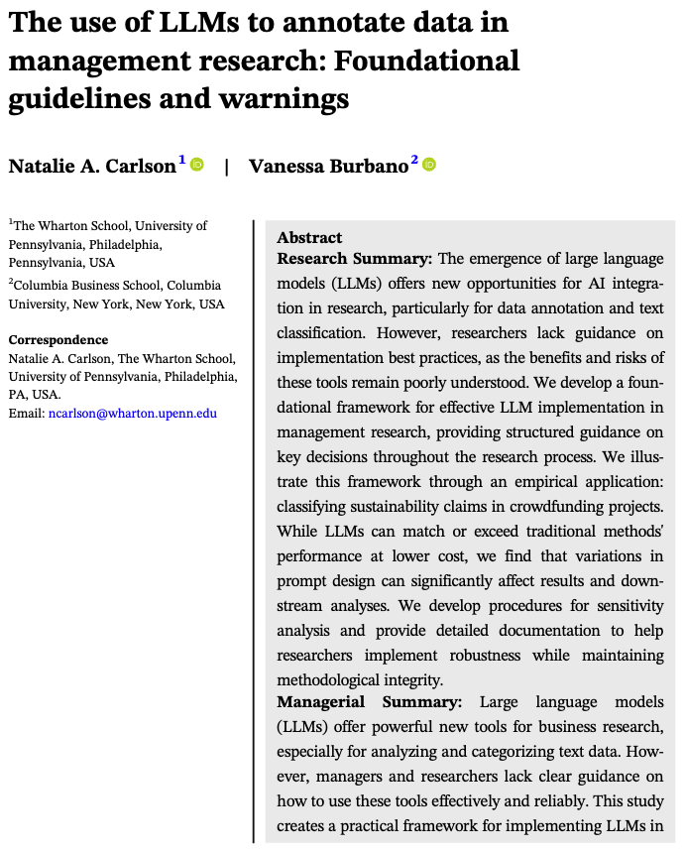
Use Case #1:
Data Classification /Annotation

Slide 4
Method | When most useful | Helpful references
Traditional ML classifier with an encoder (BERT, etc.) | Very big data and/or cost critical Stable categories Labeled training data | Choudhury, P., R. T. Allen, and M. G. Endres (2021). Machine Learning for Pattern Discovery in Management Research. Strategic Management Journal 42 (1), 30–57. Miric, M., Jia, N., & Huang, K. G. (2023). Using supervised machine learning for large‐scale classification in management research: The case for identifying artificial intelligence patents. Strategic Management Journal, 44(2), 491-519.
Fine-tuned LLM | Specialized domains (patents, medical, legal) Data large enough to justify upfront cost of fine-tuning | Chattopadhyay, S., Y. Han, F. Honore, and S. Won (2024). Getting a 25th Hour: Fine-Tuning Pre-Trained LLMs to Classify Text Data for Strategy Research. Jia, N., A. Roh, J. Song, and Y. Wei (2025). From Cognitive to Social Tasks: How AI Transforms Organizational Demand for Human Capital in Professional Service Firms.
Prompting (with API or batch labeling) ← main focus of this talk | General, nuanced concepts Smaller data + no/few training examples Emergent / exploratory analyses | Carlson, N.A., & Burbano, V. (2026). The Use of LLMs to Annotate Data in Management Research: Foundational Guidelines and Warnings (forthcoming at SMJ) Camuffo, A., Gambardella, A., Kazemi, S., Malachowski, J., & Pandey, A. (2025). LLM-as-evaluator in Strategy Research: A Normative, Variance-Aware Protocol. arXiv preprint arXiv:2601.02370.
Some other work to check out
Before we get started, people can mean a few different things when they talk about classifying with AI, so a rough guide and some great resources from other strategy scholars to share…

Slide 5

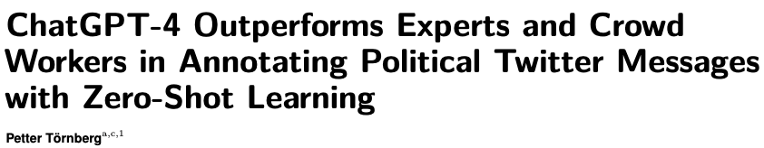
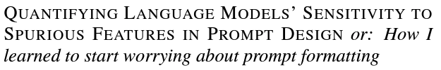
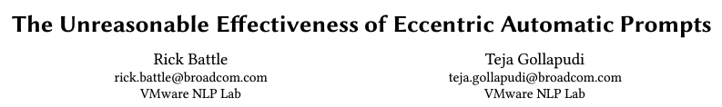
LLMs tend to perform better than crowd workers and even experts at many annotation tasks.
MOTIVATION
Historically, social scientists have used keyword/dictionary methods, or supervised ML to classify or annotate unstructured text data for use in a downstream analysis.
Naturally, they are now turning to LLMs to do this more quickly and cheaply.
What bounds do we need on this process?
But…they also do some weird stuff.

Slide 6
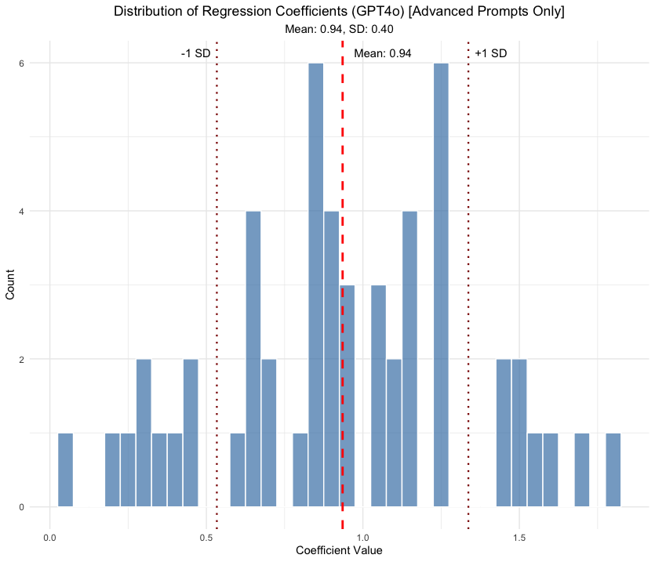

THIS PAPER
We develop a structured framework for using LLMs for annotation tasks and provide tools for researchers to apply to their projects.
We walk through an example of using this method for a task for which we previously built a supervised ML model at great effort and expense: identifying sustainability claims in Kickstarter projects.
THE UPSHOT
THE REMEDY
Performance is comparable with prior methods, with huge reduction in cost and time.
But downstream results can be sensitive to minor prompt variations…raising concerns about misuse.
Systematic sensitivity analysis can provide researchers with confidence that their findings are not artifacts of the particular model and prompt used.

Slide 7
Principle: Consider LLMs as part of a broader methodological toolkit; match method to research context and data characteristics
Tradeoffs:
Human Coding: High accuracy and nuance but expensive/slow/limited scale
Keywords/Dictionary: Transparent and simple but rigid/context-blind
Supervised ML: Scalable and consistent but requires training data/domain expertise
LLMs: Flexible and fast but potentially unstable/opaque
Best practices:
Begin with clear task specification and success criteria
Use human coding for validation and complex edge cases
Consider hybrid approaches
Document relative performance across methods
01
METHOD SELECTION AND INTEGRATION
(Do we use LLMs or another method?)

Slide 8
Principle: Prioritize reproducibility and documentation over cutting-edge performance
Tradeoffs:
Newer models: Better performance but less tested/stable
Older models: More stable but potentially lower performance
Open vs. closed models: Access/cost vs. performance
Reasoning models: Better at complex problem solving vs. inefficient for basic annotation
Best practices:
Document model version and access method
Test multiple models as part of sensitivity analysis
Archive model weights (if open-source) or maintain access to older versions if possible
Plan for replication needs
Consider data security if annotating sensitive data (check policies around usage and storage)
02
MODEL SELECTION AND STABILITY
(Which LLM should we be using?)

Slide 9
Principle: Structure prompts systematically and transparently; document thoroughly
Tradeoffs:
Simple prompts: More stable but potentially lower accuracy
Complex prompts: Better performance but higher token usage
Generic vs. task-specific prompting: Generalizability vs. accuracy
Best practices:
Generate systematic prompt variations for sensitivity testing
Document all prompt components
Test prompts on diverse examples
03
PROMPT ENGINEERING
(How do we design and validate our prompts?)

Slide 10
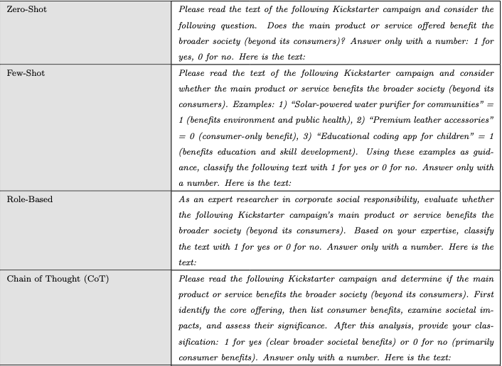
PROMPTING STRATEGIES

Slide 11
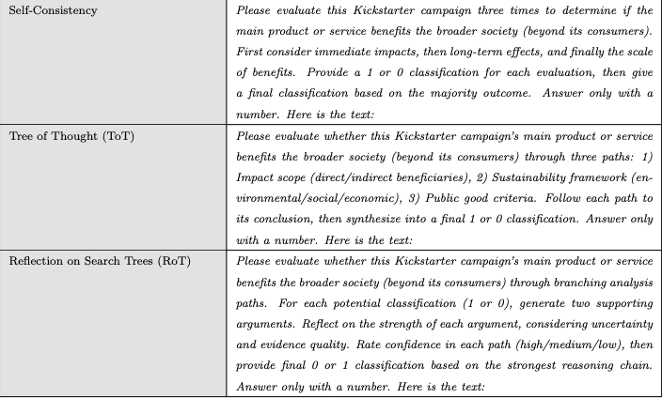
PROMPTING STRATEGIES (cont.)

Slide 12
Principle: Balance resource usage with statistical power and robustness needs
Tradeoffs:
Sample size vs. token usage
Prompt complexity vs. processing cost
Depth vs. breadth of sensitivity testing
Model size vs. performance gains
Best practices:
Plan sensitivity analysis within resource constraints
Document cost structure and optimization decisions
Consider computational constraints for replication
04
COST AND SCALE CONSIDER-
ATIONS
(How do we optimize resources while maintaining rigor?)

Slide 13
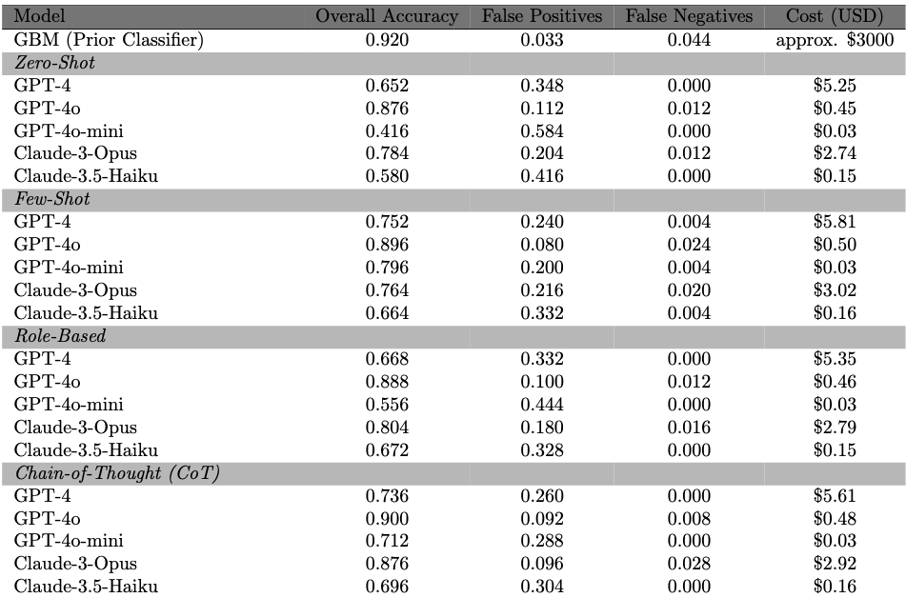
FIRST STAGE RESULTS
GPT-4o tends to perform well regardless of prompt – lightweight models can vary wildly depending on prompt structure

Slide 14
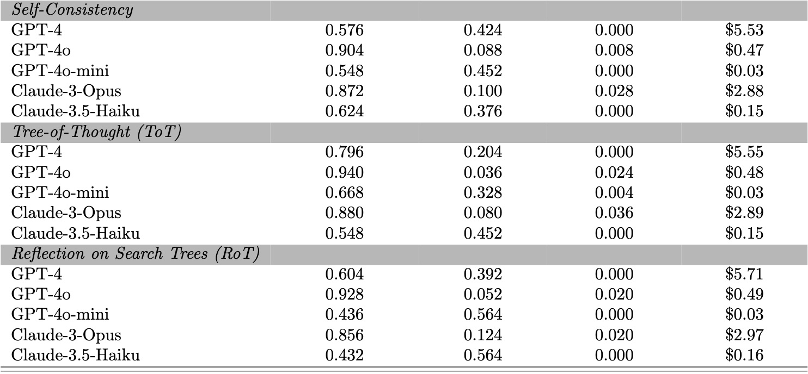
FIRST STAGE RESULTS
(cont.)
GPT-4o tends to perform well regardless of prompt – lightweight models can vary wildly depending on prompt structure

Slide 15
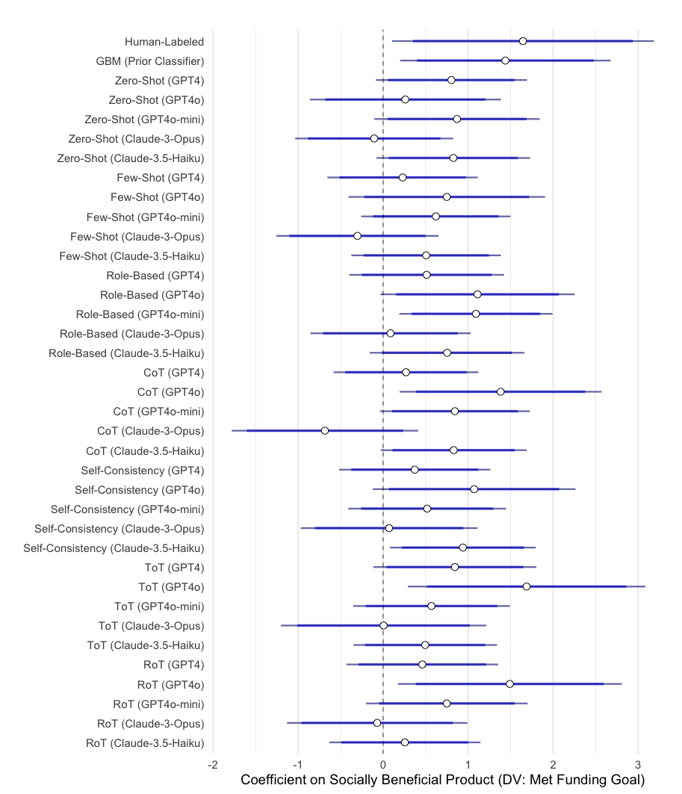
SECOND STAGE RESULTS
← 87.6% accuracy: 9.8% false positives, 2.8% false negatives
Good performance in the first stage does not necessarily translate to better recovery of the “true” downstream effect! This is why sensitivity testing becomes essential – not just sensitivity testing of the classification error, but of the downstream estimates.

Slide 16
Principle: Conduct systematic evaluation of result validity and stability
Tradeoffs:
Depth vs. breadth of validation testing
Cost of comprehensive testing vs. confidence in results
Best practices:
If feasible, maintain gold-standard expert-coded subset
Generate systematic prompt variations
Test impact on downstream analyses
Provide bounded estimates for key findings
Document null results and validation protocols
05
VALIDATION AND ROBUSTNESS
(How reliable and stable are our findings?)

Slide 17
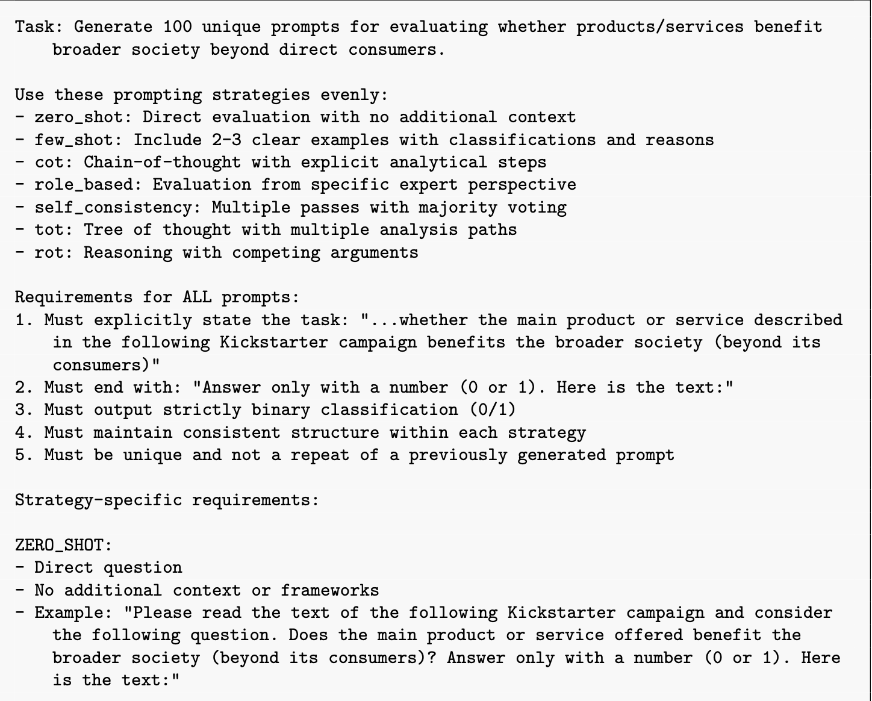
TEMPLATE FOR PRODUCING FAMILIES OF PROMPT VARIATIONS
It continues on…
see paper for details! →

Slide 18
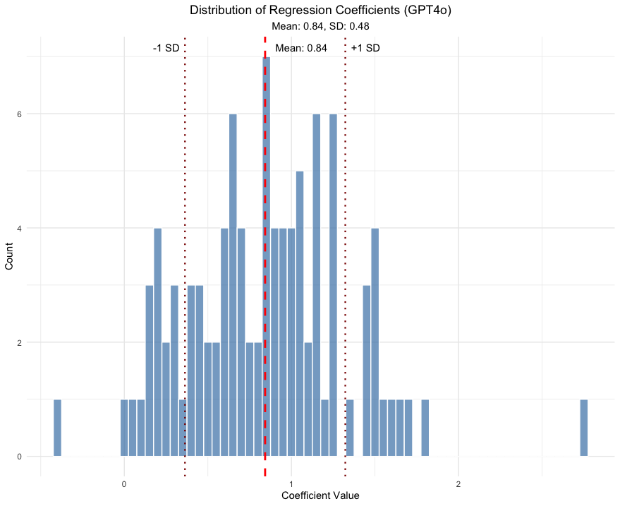
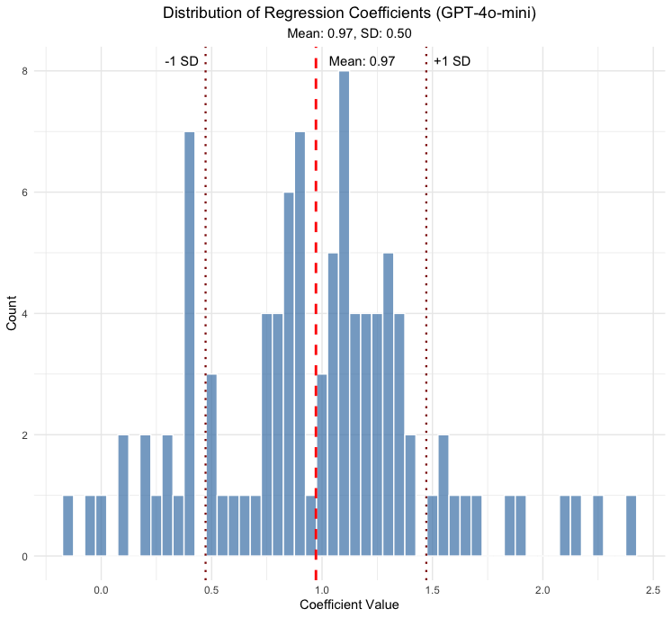
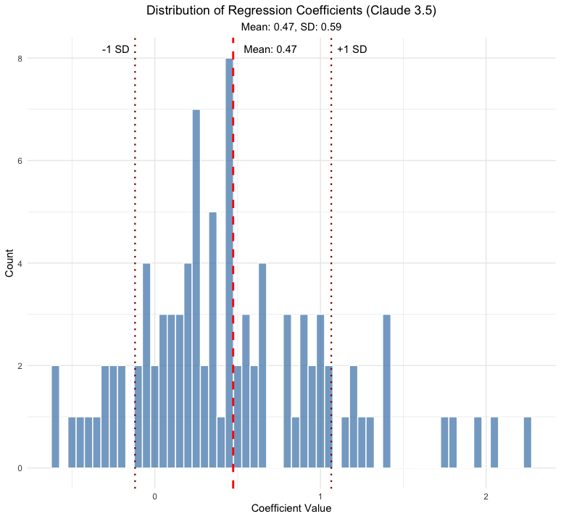
SENSITIVITY ANALYSIS
Here we can assess sensitivity of the downstream coefficient across models…

Slide 19
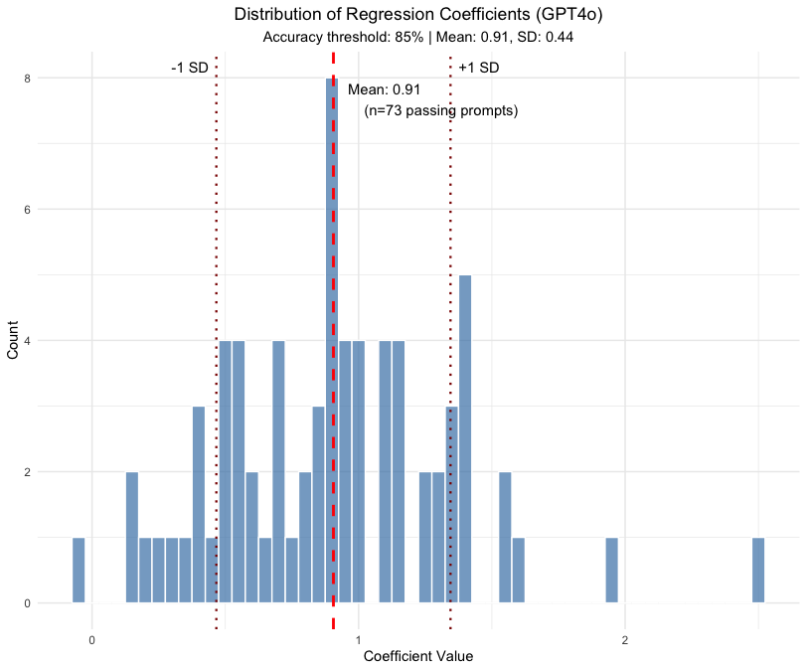
SENSITIVITY ANALYSIS (cont.)
…with the option to restrict to advanced prompting strategies or drop those that don’t meet a certain accuracy threshold in the first stage

Slide 20

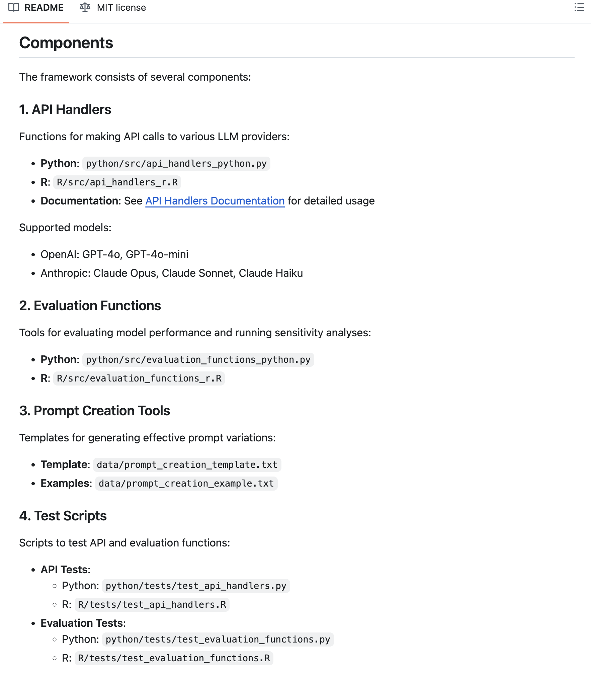
Sample code to get started
https://github.com/LLMAnnotationResearch/llm-annotation-framework

Slide 21
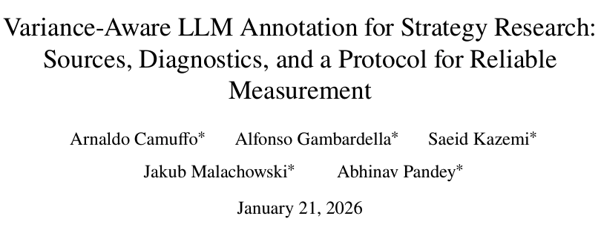
Some recent relevant extensions + guidance
Additional guidance from Camuffo et al. (2026):
Explicit no-use applications
High-stakes individual decisions
Culturally sensitive judgments
Technical/proprietary material
Where experts disagree
Pre-registration standards
Maintain audit set to detect drift
Keep a fixed “audit set” of examples and rerun it whenever the model, version, or settings change
More concrete documentation rules

Slide 22
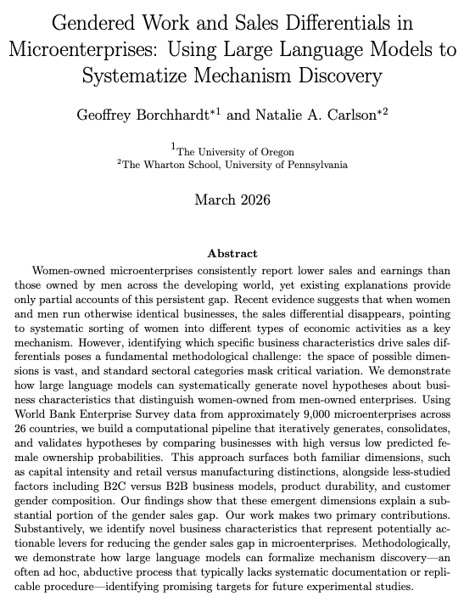
Use Case #2:
Unstructured Feature / Mechanism Discovery

Slide 23

Motivation
Women-owned microenterprises consistently generate lower profits and returns to capital than those owned by men (Delecourt & Fitzpatrick, 2021; Delecourt & Ng, 2021; Doering & Liu, 2019).
Gendered work in microenterprises
We are interested in the extent to which this is driven by the types of businesses women and men sort into, beyond broad sectoral categories.

Slide 24
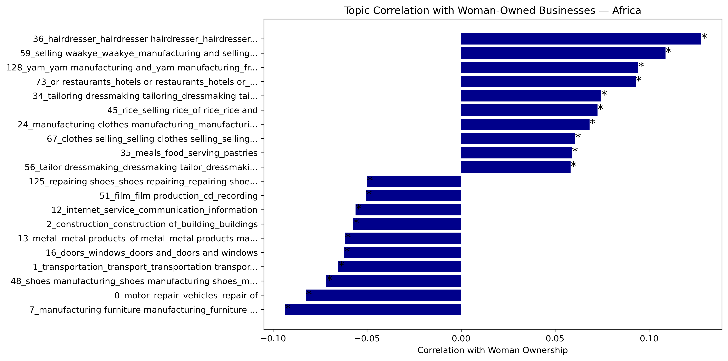
Characterizing “Women’s Work”: Africa
Results from BERTopic model with 136 topics
Notes:
BERTopic first uses a transformer model (like Sentence‑BERT) to convert each document into a semantic embedding, then reduces those high‑dimensional vectors (e.g., with UMAP) and groups similar ones via clustering (like HDBSCAN). Finally, it identifies keywords for each cluster using class‑based TF‑IDF (c‑TF‑IDF), yielding concise, interpretable topic labels

Slide 25
The Methods Puzzle: How Do We Explore the Space of “Women’s Work”?
Many plausible channels. Capital, skills, customers, norms, timing, sector, products… lots of ways women’s and men’s businesses might differ.
Hypothesis generation is ad hoc. We usually pick a few mechanisms based on priors, anecdotes, or what’s easy to measure (Ludwig and Mullanaithan, 2024).
Rich text, limited tools. Business descriptions contain detailed information, but we lack a systematic way to mine them for candidate mechanisms.
Gendered work in microenterprises

Slide 26
Empirical Approach: LLM-Based Mechanism Discovery
Data: ~9,000 microenterprises in 26 LMICs
– World Bank Microenterprise Surveys
– Business descriptions + gender + registration status + earnings
Goal: Identify which business characteristics systematically differ between women- and men-owned firms, beyond standard sector codes.
Approach: Use a multi-stage LLM pipeline to
surface candidate dimensions where Group A (women-owned) and Group B (men/joint-owned) differ
consolidate these into stable, interpretable features
test how these features account for the gender earnings gap
Gendered work in microenterprises

Slide 27
LLM Mechanism Discovery Pipeline: Generation
I have two sets of business descriptions from microenterprises. Group A and Group B represent businesses that differ on some characteristics.
GROUP A:
{group_a_text}
GROUP B:
{group_b_text}
Analyze these descriptions and identify systematic differences between the two groups. What patterns distinguish Group A from Group B?
Return your response as a JSON array where each element represents a distinct hypothesis about how the groups differ:
[
{{
"hypothesis": "Clear comparative statement describing how Group A differs from Group B on a specific dimension (e.g., 'Group A... while Group B...')",
"dimension": "Name of the dimension being compared"
}},
...
]
Each hypothesis must explicitly compare both groups. Focus on concrete, observable characteristics that could be reliably coded by researchers. Return only valid JSON with no additional text.
Pull a bunch of examples of businesses from each group and use repeated UPI calls to surface hypotheses about what distinguishes the businesses between the two groups

Slide 28
[pipeline
walkthrough]

Slide 29
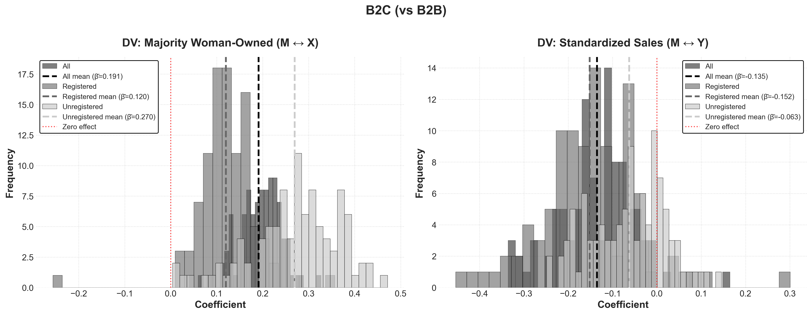
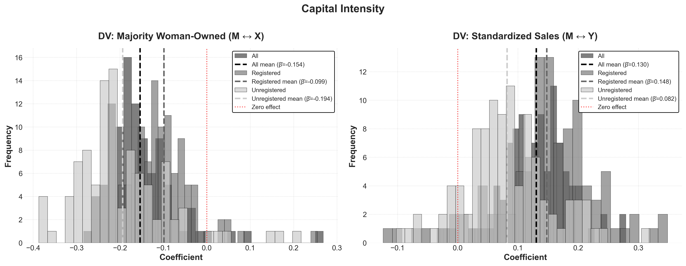
Identifying Promising Candidates From Our Features of Interest
Controlling for country, year of data collection, and founding year, we observe general patterns of correlation between (a) each feature and gendered ownership, and (b) each feature and earnings

Slide 30
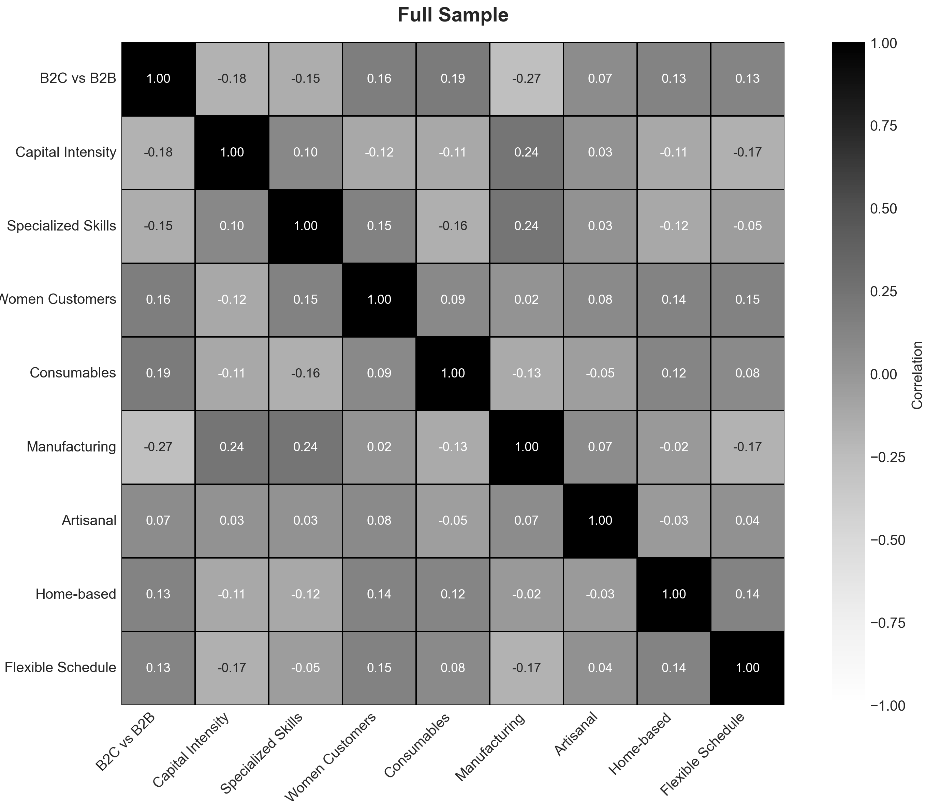
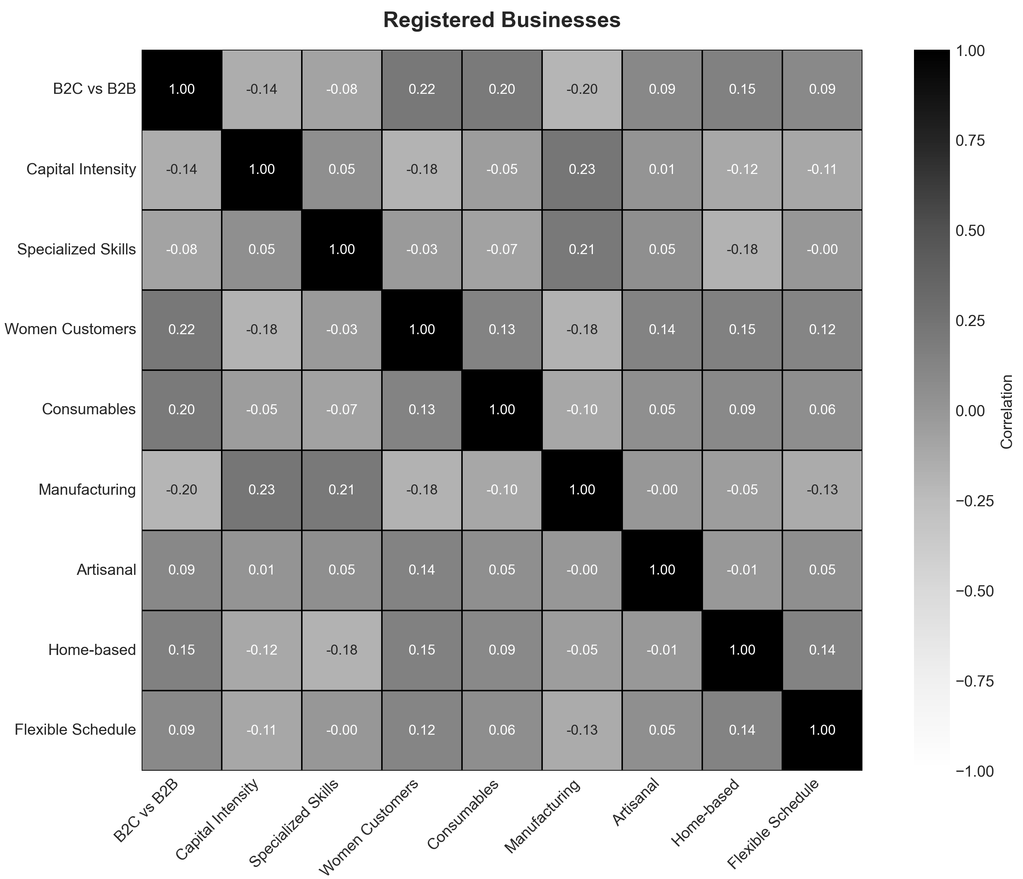
How Should We Think About Intra-Feature Correlation?
We use Shapley Decomposition to try to disentangle these related features and assess relative contribution to the gendered earnings gap across businesses

Slide 31
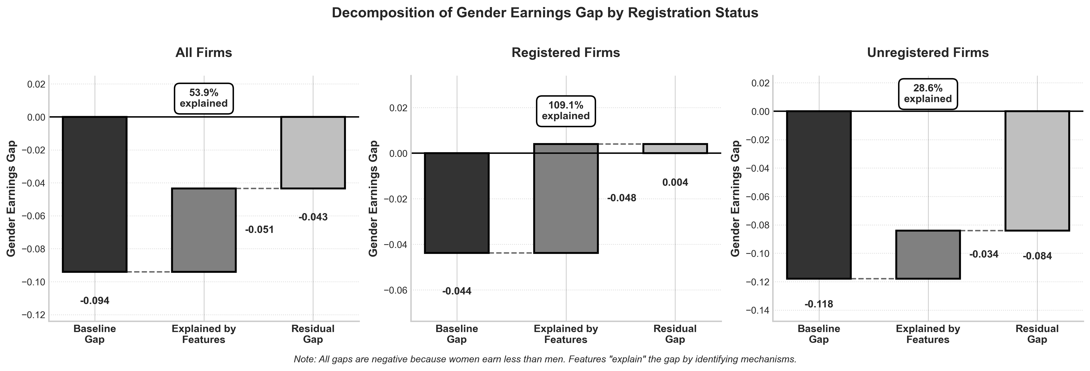
Results of Shapley Decomposition
Registered firms have a smaller gender gap in earnings, that is in effect wholly explained by our business features. Unregistered firms have a larger gap, of which only about a third is explained by our features.

Slide 32
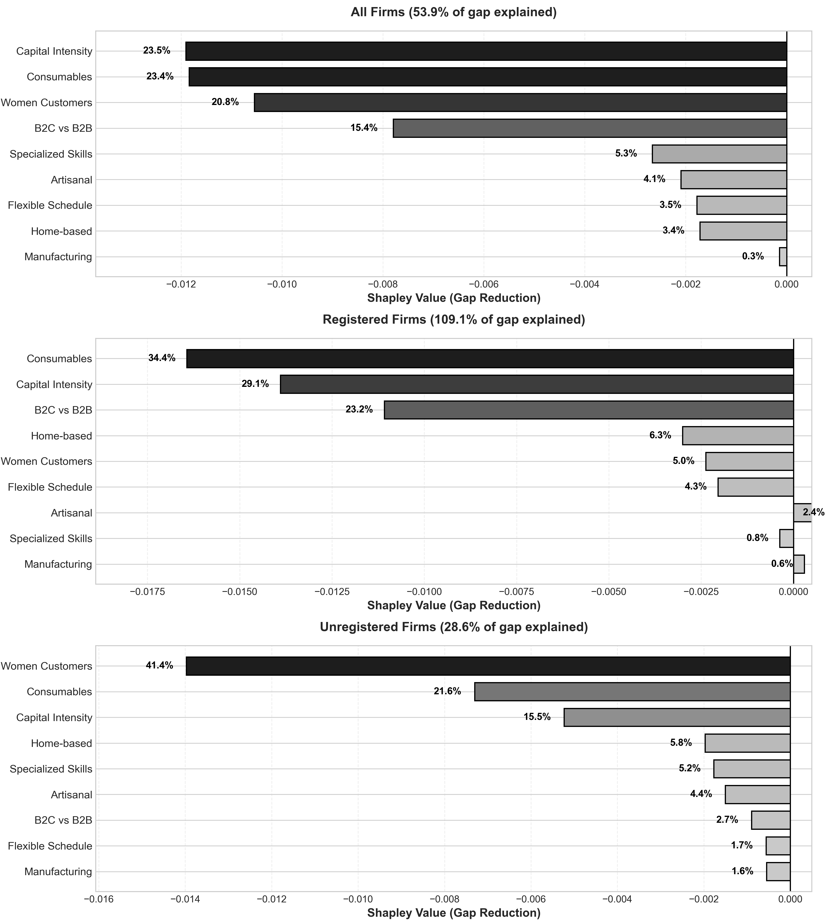
Shapley Decomposition: Full Sample
For all firms, lower capital intensity sectors and selling consumables are important explanatory features of the gender earnings gap. For registered firms, selling B2C rather than B2B is relevant, while for unregistered firms, selling primarily to women customers surfaces as an important explanatory factor

Slide 33
Broader reflections: making abduction auditable
The pipeline makes the typically invisible hypothesis-generation process transparent and replicable
Unlike traditional mechanism identification (pick one M, present as if it followed from theory), this documents the full candidate space
Connects to Pillai et al. (2025) PEEBI testimonial structure — our pipeline surfaces the lot of "Es" systematically
We see this as about improving the "pre-scientific stage of science” (Ludwig & Mullanaithan, 2024), not replacing experimental validation – instead fitting into broader research programs
Gendered work in microenterprises

Slide 34
Extensions Beyond Our Microenterprise Setting
Field experiments: apply pipeline to unstructured data (open-ended surveys, call logs) to diagnose unexpected nulls or heterogeneity
Other domains: hiring discrimination, startup funding, social movements (anywhere the hypothesis space is vast and text data is rich)
The approach is pre-registrable, maintaining transparency
Gendered work in microenterprises

Slide 35
Resist the temptation to regard LLMs as “oracles” – I find it useful to regard them as motivated actors; if you wouldn’t let a lone RA run wild on your data, don’t do it with LLMs either!
But many, many bounded micro-deciders working together with tightly prescribed degrees of freedom — powerful
Both of these papers are really about building optimal architecture for integrating LLMs robustly into research processes:
Leveraging wisdom of crowds logic by engineering independence of LLM inputs
Making hidden points of researcher discretion visible/auditable
Emphasizing stability of conclusions rather than exact reproducibility (generally impossible with non-deterministic inputs)
Maintaining the role of (human) researcher expertise
CONCLUSION
(& thank you!)
Returning to these meta-themes:

