Slide 1

Managing
Team-Based
Experiments
Practical Realities That
Shape Your Methods
Dorothy R. Carter, Ph.D.
Associate Professor | Michigan State University
CARMA PhD Panel | April 10, 2026

Slide 2
The practical work
IS the methodological work.
Two experiments where everyday logistics
directly shaped the methods and the science.

Slide 3

MICHIGAN STATE UNIVERSITY
PROJECT
FUSION
Facilitating Unified Systems of Interdependent Organizational Networks
NASA #80NSSC18K0511 (PI: Carter)
Collaborating Institutions:
Northwestern University
Northeastern University
Clemson University
University of Georgia
University of Central Florida
George Mason University
NASA KBRWyle

Slide 4
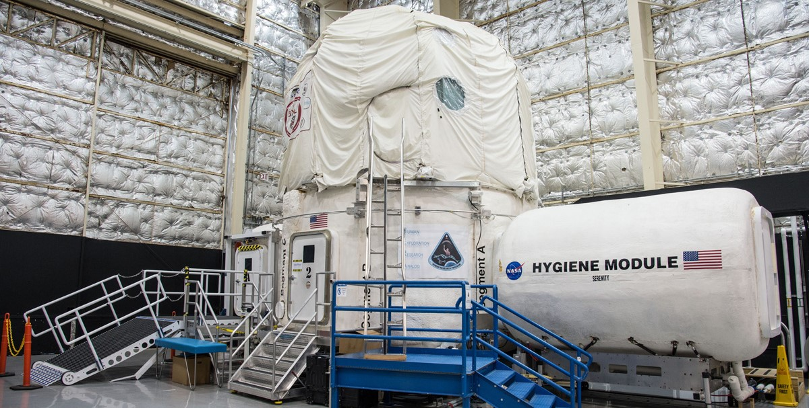
HERA: Human Exploration Research Analog
45 days sealed in a capsule. No do-overs.

Slide 5
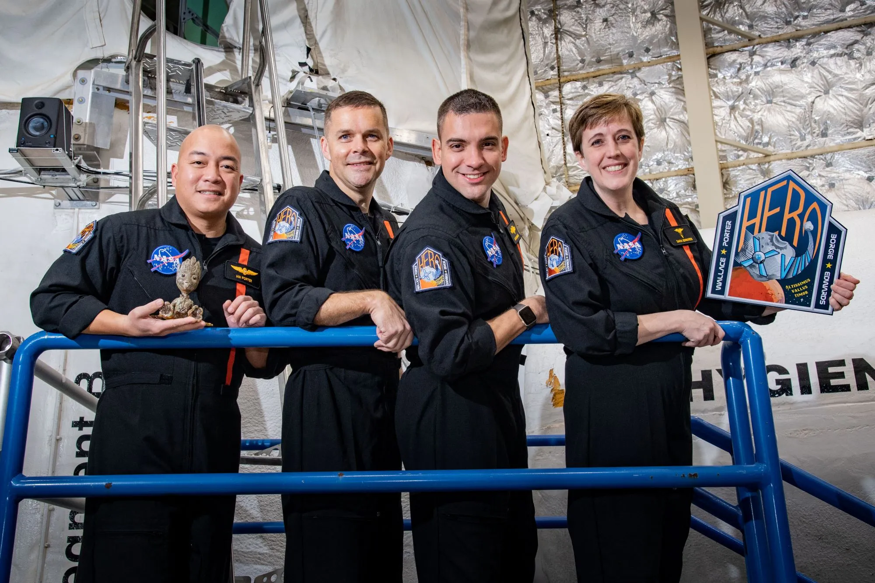
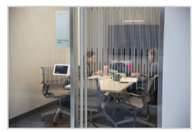
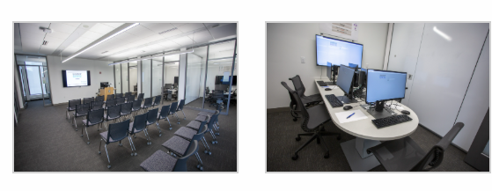
Two Locations, One Experiment
HERA Capsule — Johnson Space Center
4 crew members sealed for 45 days
Kesseler Team Leadership Lab — Michigan State University
8 participants in the university MCC

Slide 6
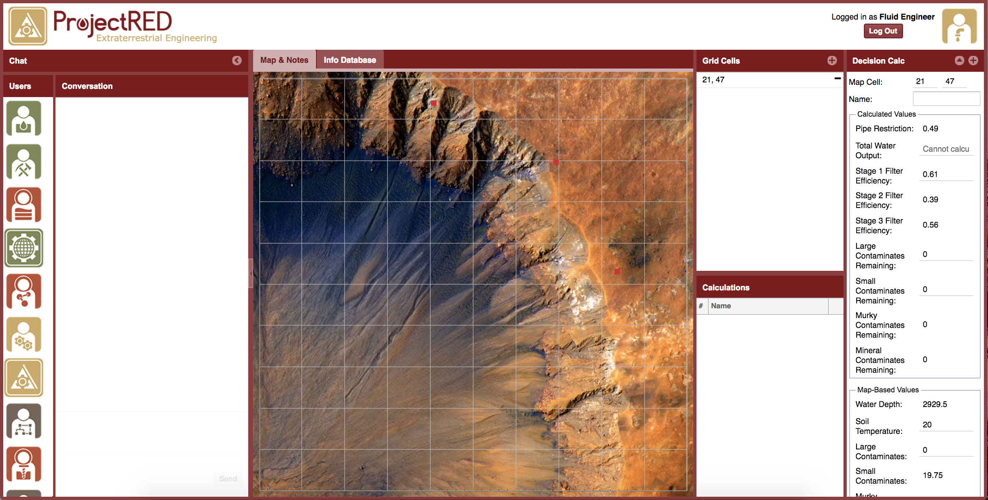
The Team Task: Project RED Mars Simulation
Teams collaborated to select an ideal location on Mars and design a well to provide clean water —
all while communication was delayed by up to 3 minutes.

Slide 7
The Communication Delay Manipulation
Same 12 participants completed Project RED simulation FOUR times across the 45-day mission
Time 1
Time 2
Time 3
Time 4
No Delay
(Control)
1-Min
Delay
3-Min
Delay
No Delay
(Control)
Day ~3
Day ~16
Day ~29
Day ~42
Within-subjects design: every team experienced all conditions. No second chances with irreplaceable data.

Slide 8
What Could Go Wrong
Synchronizing across
two locations
Technology inside
an isolated capsule
No fixing it
next semester
HERA crew at JSC and MCC team at MSU had to operate in perfect sync across hundreds of miles — timing, technology, and task delivery.
The entire tech stack had to function flawlessly inside HERA with extremely limited access for troubleshooting.
You cannot re-run a 45-day analog mission. Every protocol decision, every piece of equipment had to be right the first time.

Slide 9
NASA HERA: What I Learned
1
Pilot everything — including the coordination
We ran multiple full-scale pilot sessions with research assistants before the HERA mission. Piloting measures wasn’t enough — we had to pilot the entire cross-location workflow (during crew training).
2
Build relationships with your partners early
Working with NASA meant navigating institutional timelines, security protocols, IRBs, and scheduling constraints. Those relationships had to be built long before data collection.
3
Design for irreplaceable data
With only two HERA campaigns, every choice carried enormous weight. We used within-subjects specifically because we couldn’t afford between-group variability.
Needed “backup” participants at university lab because of repeated measures design.

Slide 10
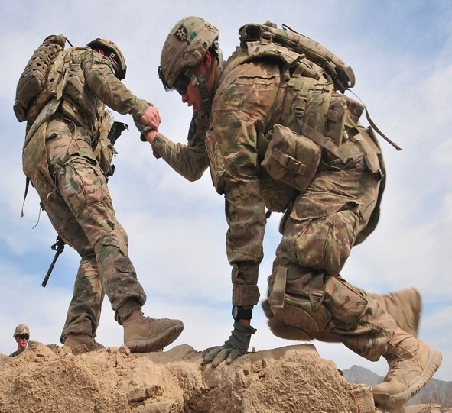
MICHIGAN STATE UNIVERSITY
TEAMS Paradigm
Transportable Experiment for Advancing
Mission Success
Army Research Institute for the Behavioral and Social Sciences (ARI)
Cooperative Agreement W911NF-19-2-0173
Collaborating Institutions:
Rice University
Clemson University
Florida Institute of Technology
Aptima
Group for Organizational Effectiveness

Slide 11
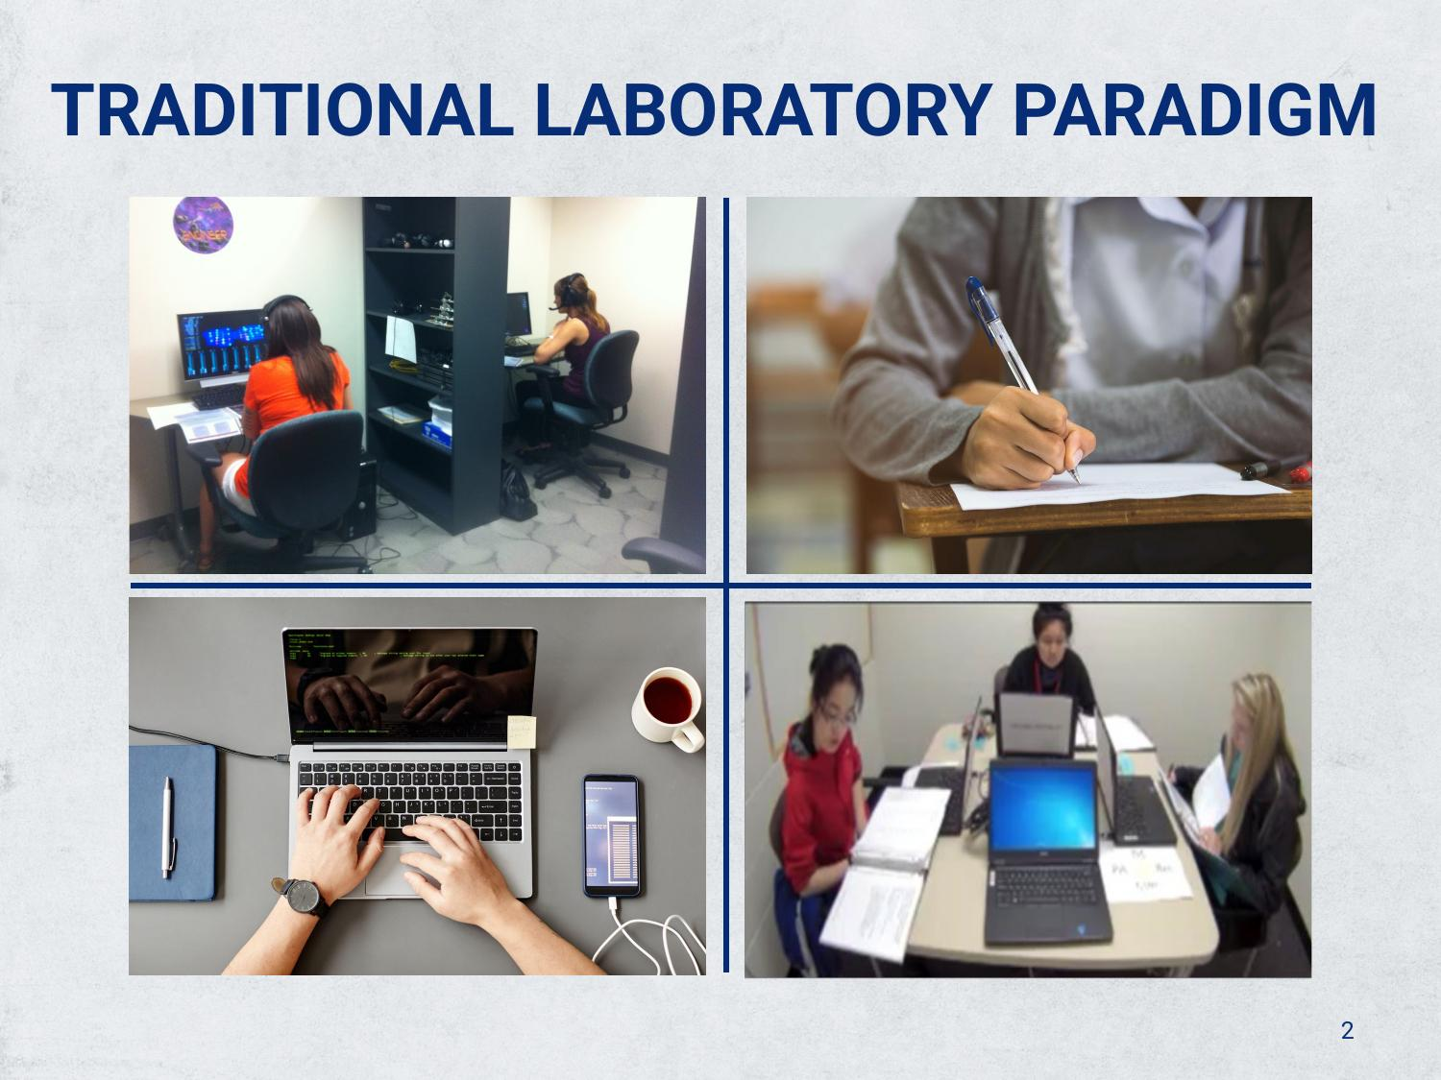
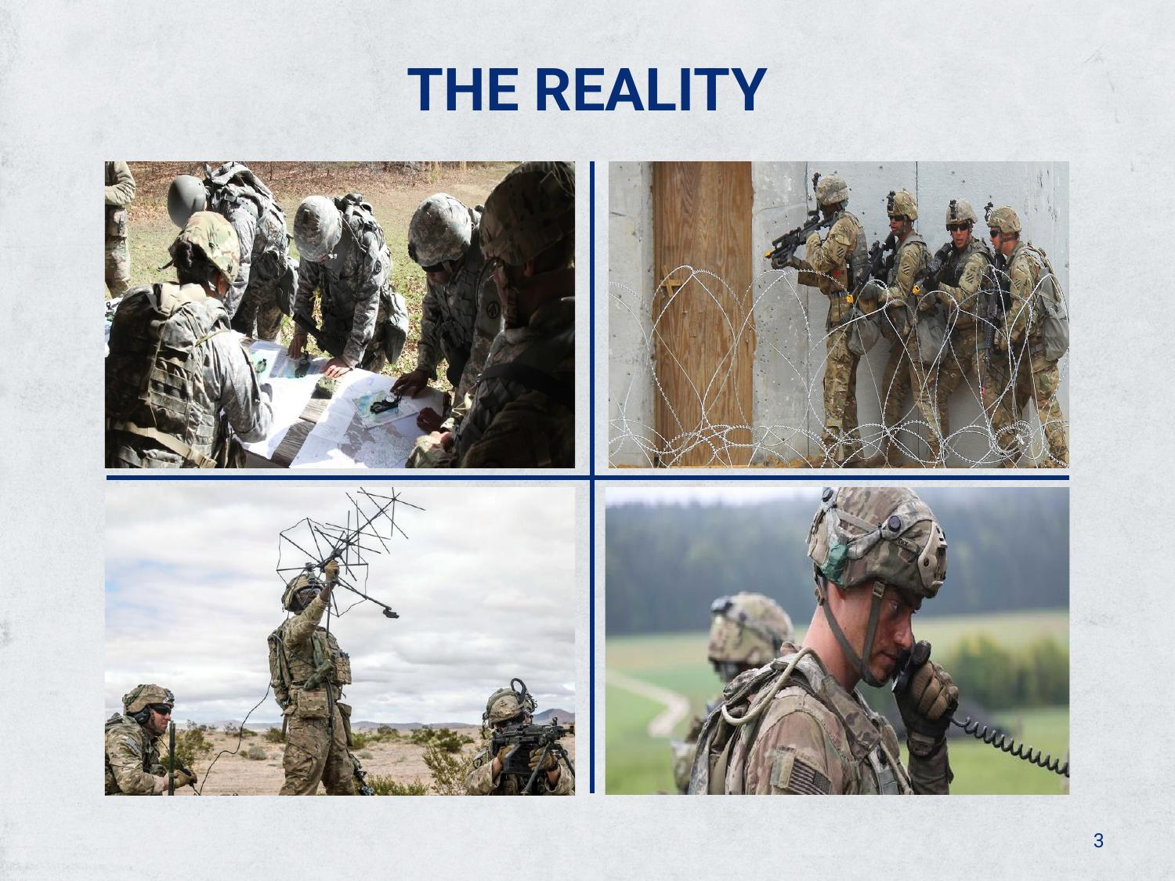
Army TEAMS: Moving Research Out of the Lab
Can findings from computer-based lab studies really generalize to teams working in physical, high-stakes environments?

Slide 12
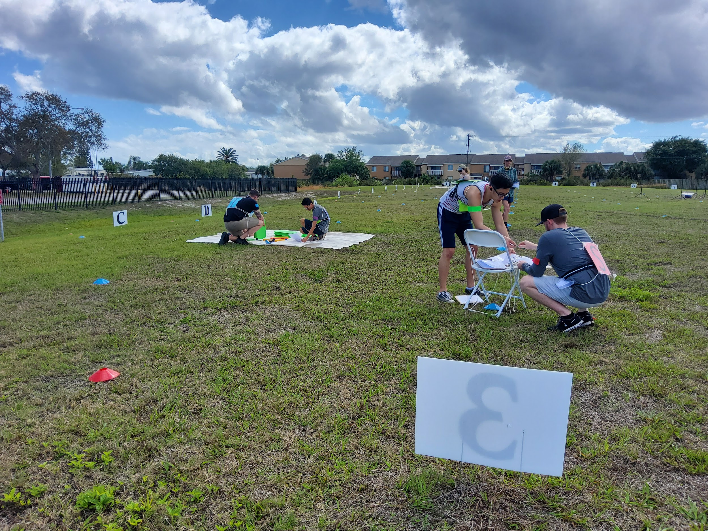
The TEAMS Paradigm - Teams in Physical Space
MSU (Carter) · Clemson (Shuffler) · Florida Tech (Thayer) — Three sites, one protocol.

Slide 13
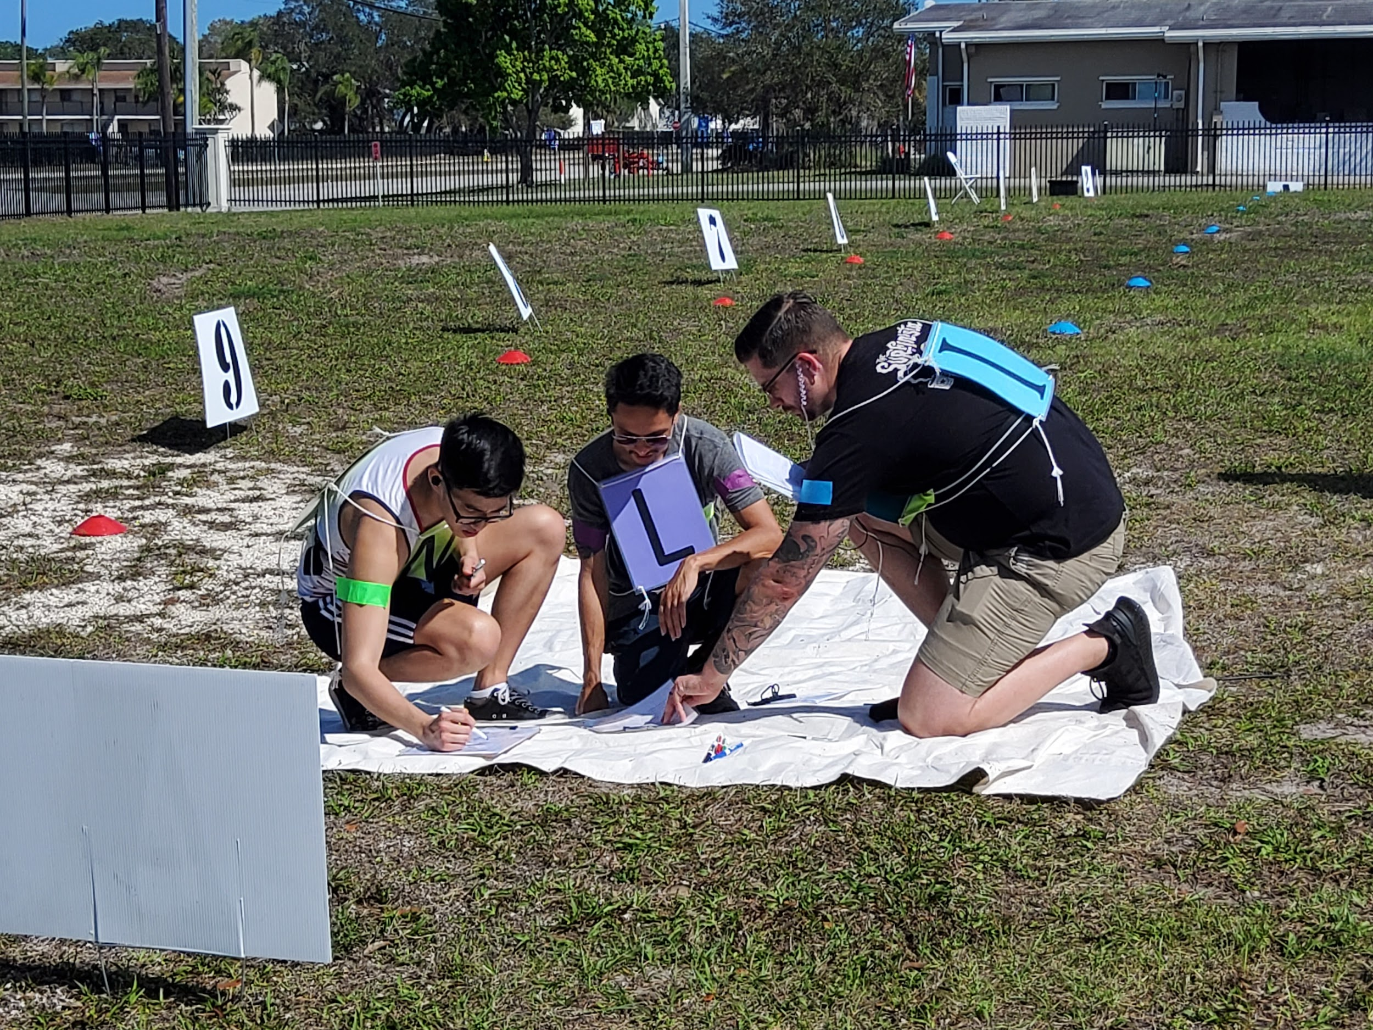
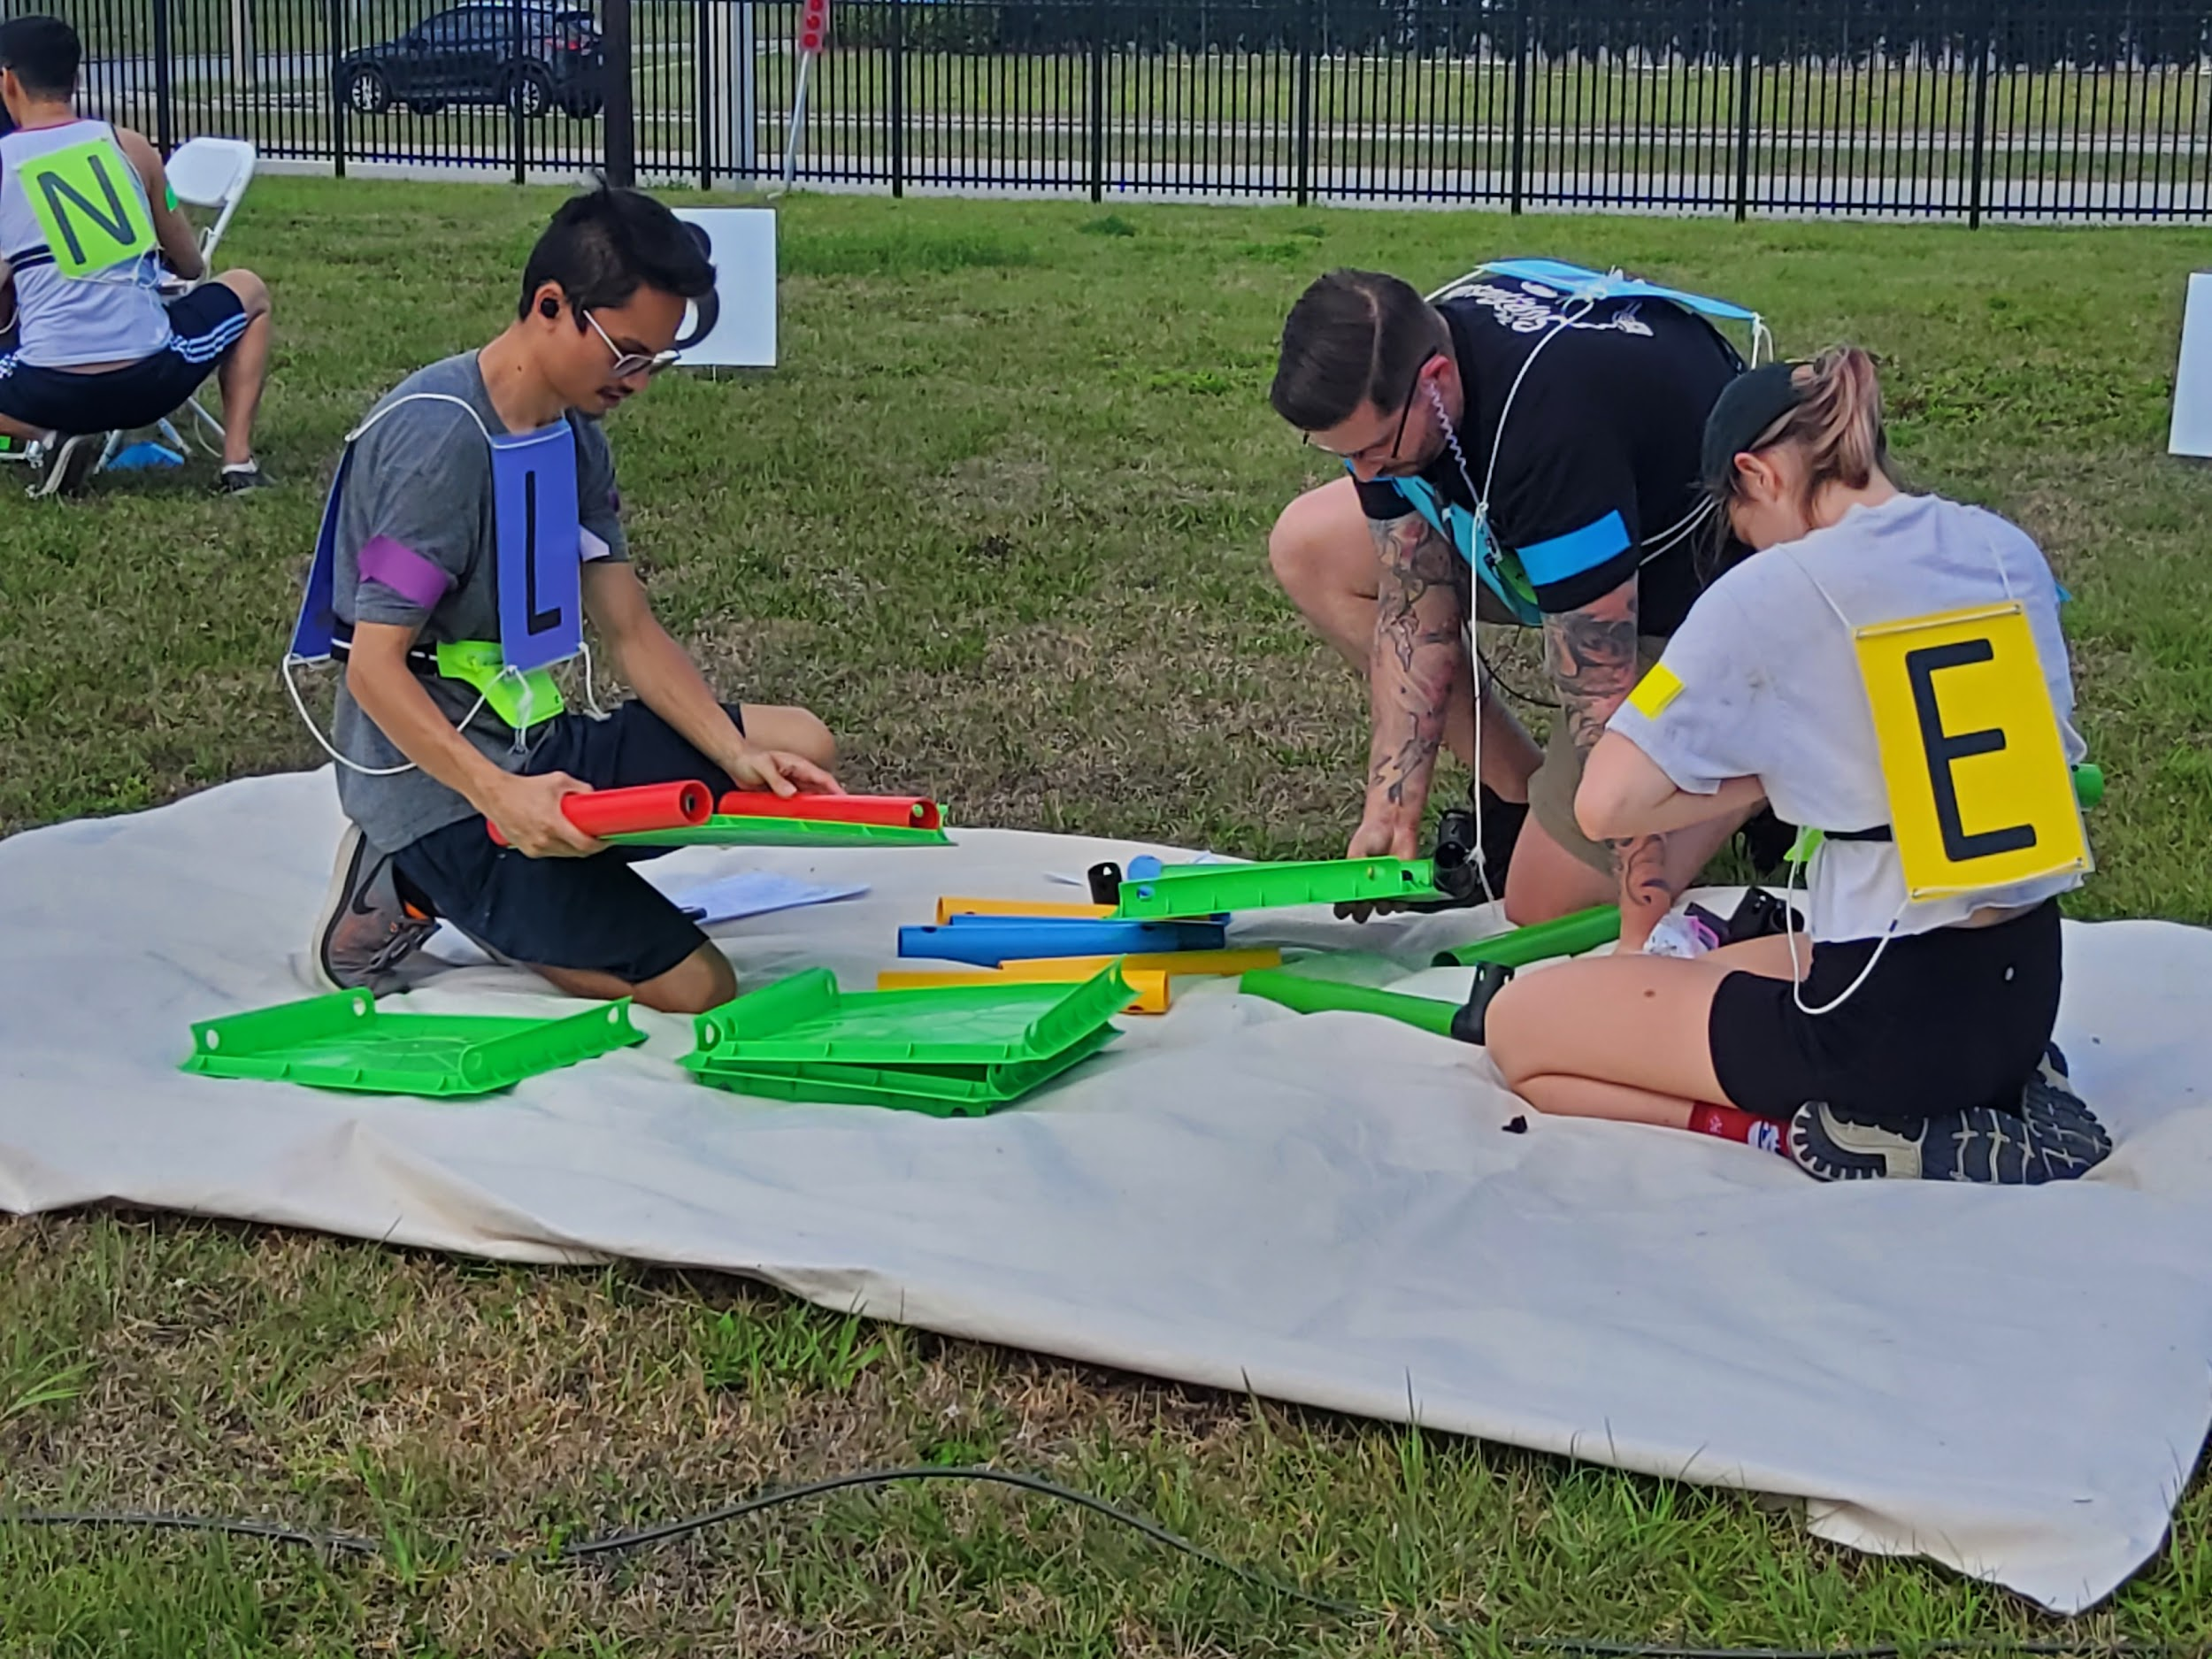
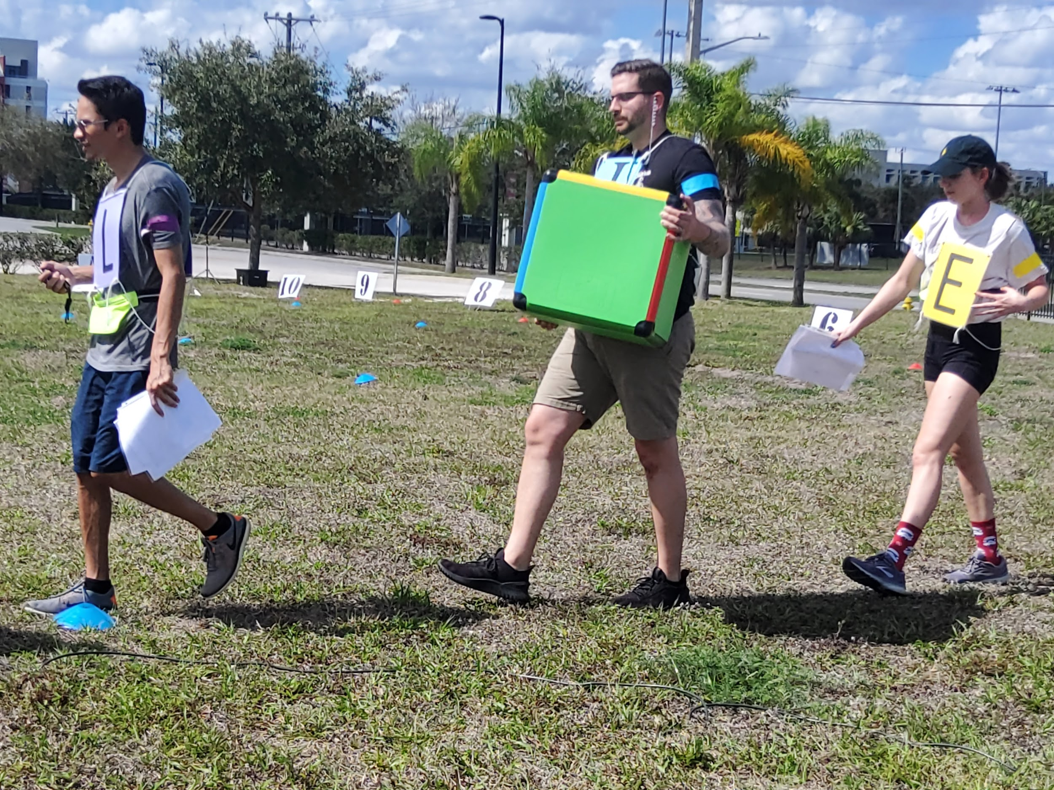
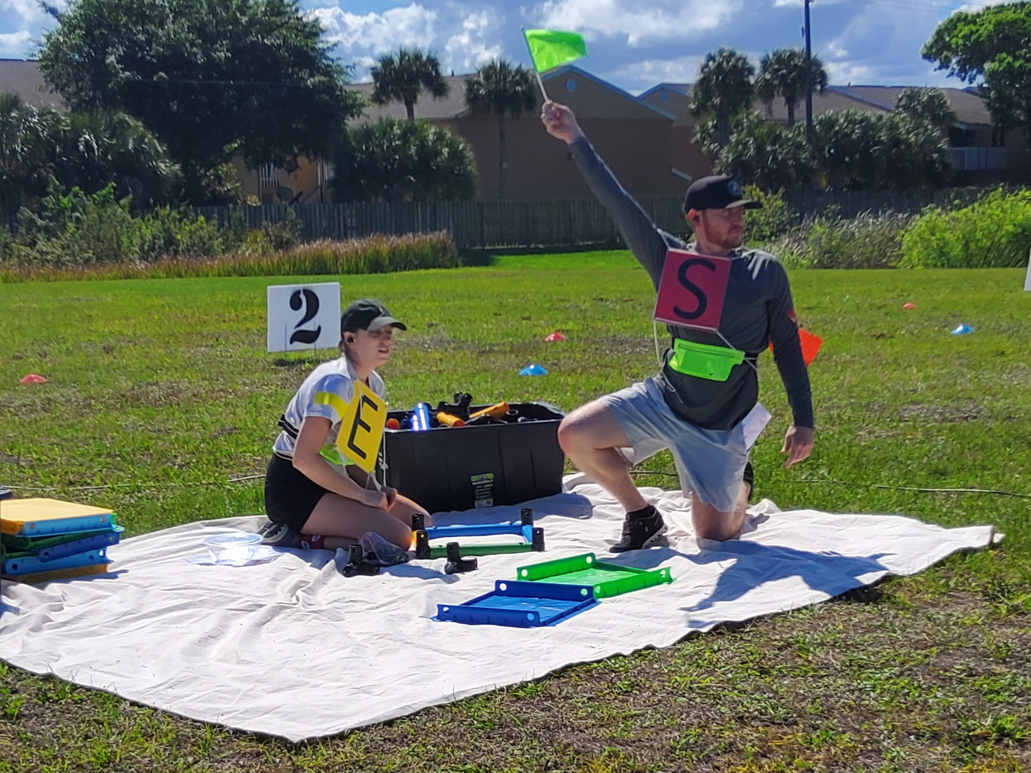
Teams in Action
Strategizing on the field
Building the cart
Navigating with supplies
Signaling during mission

Slide 14
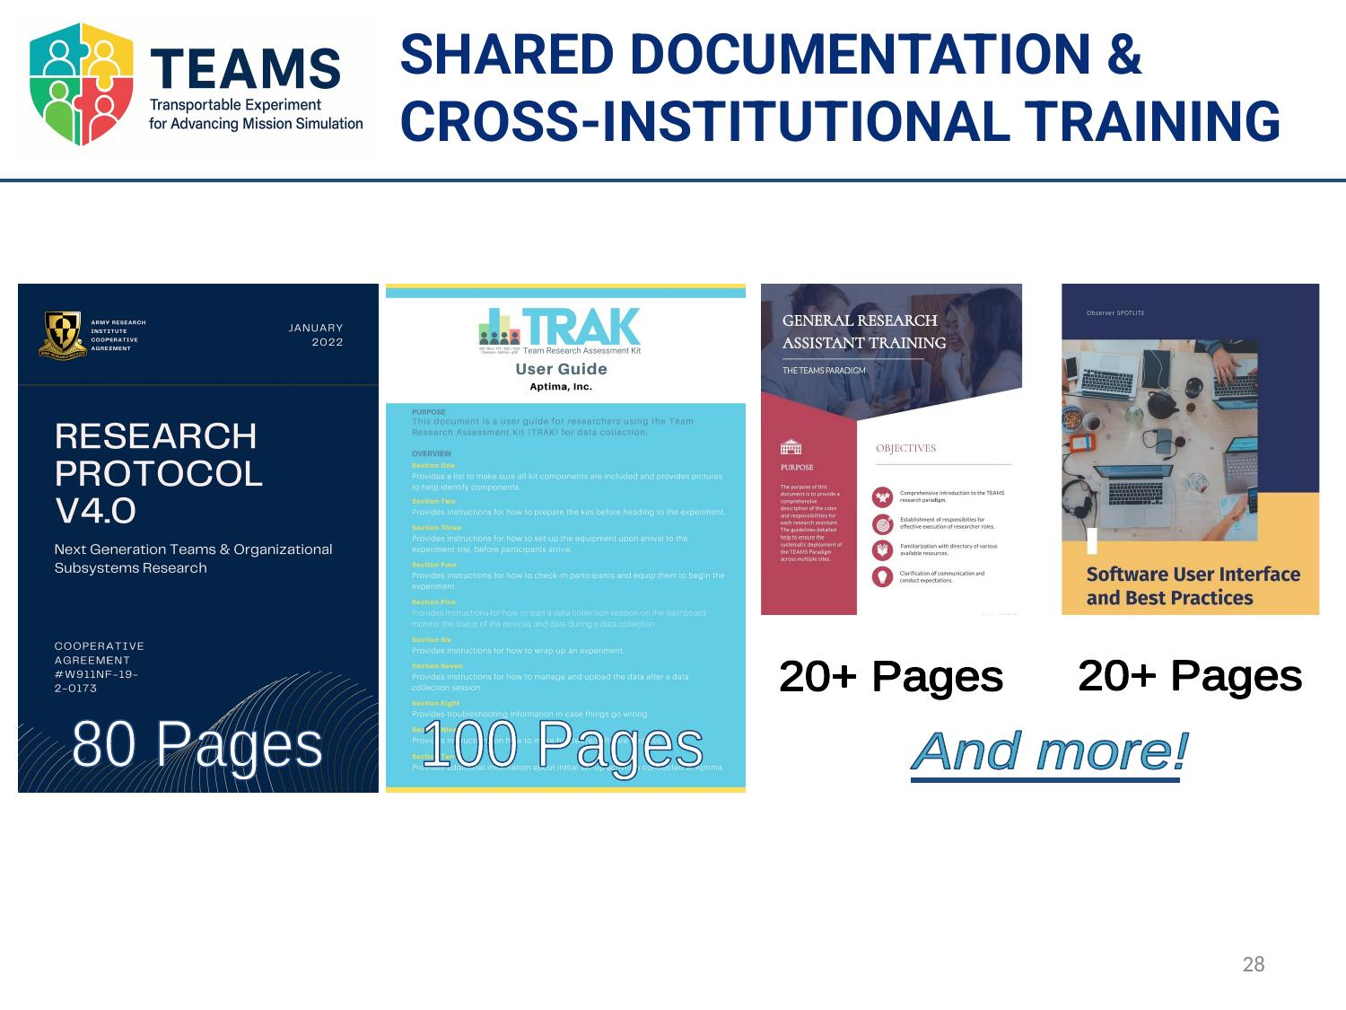
Three Sites, One Protocol
Collaboration
MSU, Clemson (Marissa Shuffler),
and FIT (Amanda Thayer)
80-page research protocol
Every procedural detail standardized
100-page TRAK guide
Data collection kit documentation
20+ page RA training manuals
Cross-institutional training to one standard
Shared documentation website
Central repository for all materials

Slide 15
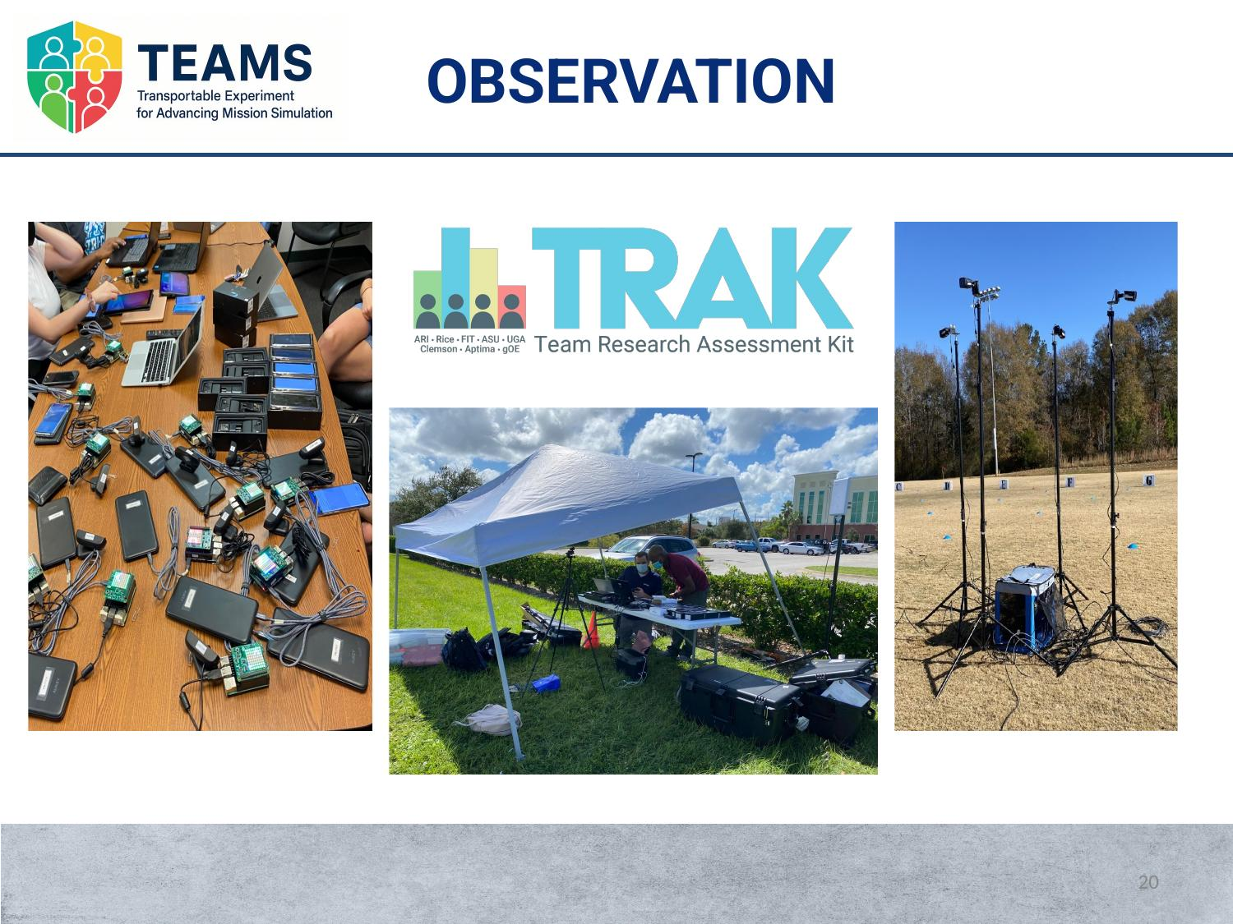
The Equipment: TRAK Data Collection Kit
Smartphones, Bluetooth beacons, cameras, tablets, generators, walkie-talkies — all configured identically at every site.

Slide 16
ARI TEAMS: Practical Challenges
Protocol
Standardization
Physical Space
Variability
Technology &
Data Coordination
Three different universities had to run identical procedures. An 80-page protocol and 100-page TRAK guide were the backbone of experimental control.
Different outdoor or indoor fields at each campus — different dimensions, surfaces, weather. Grid markers, cones, and spatial specs kept it standardized.
All sensors, devices, and software configured identically. Cloud-based data management enabled real-time quality checks across sites.

Slide 17
ARI TEAMS: Lessons Learned
1
Document your procedures AS your methods
The 80-page protocol wasn’t bureaucracy — it was the only thing keeping three sites in sync. Write procedural decisions down as you go, not after.
2
Build redundancy into everything
Over-recruit participants. Have backup equipment at every site. Train more RAs than you think you need. The cost of redundancy is always less than the cost of lost data.
3
Invest in shared infrastructure from day one
Our documentation site, cloud data management, and cross-institutional training took months to build — but they’re what made multi-site experimental research possible.

Slide 18
Thank You
Dorothy R. Carter, Ph.D.
Associate Professor | Department of Management
Broad College of Business | Michigan State University
dcarter3@msu.edu

