Slide 1


Let’s Be Clear: Treatments & Primes
Based on: Schabram, K. F., Myers, C. G., & Hardin, A. E. (2026). Manipulation in Organizational Research: On Executing and Interpreting Designs from Treatments to Primes. Organizational Research Methods, 29(2), 177-201.
CARMA PHD PREP PANEL | Practical Realities of Running Experiments and How They Shape Your Methods
Christopher G. Myers, PhD Peetz Family Professor of Leadership Johns Hopkins University Carey Business School
cmyers@jhu.edu christophergmyers.phd

Slide 2
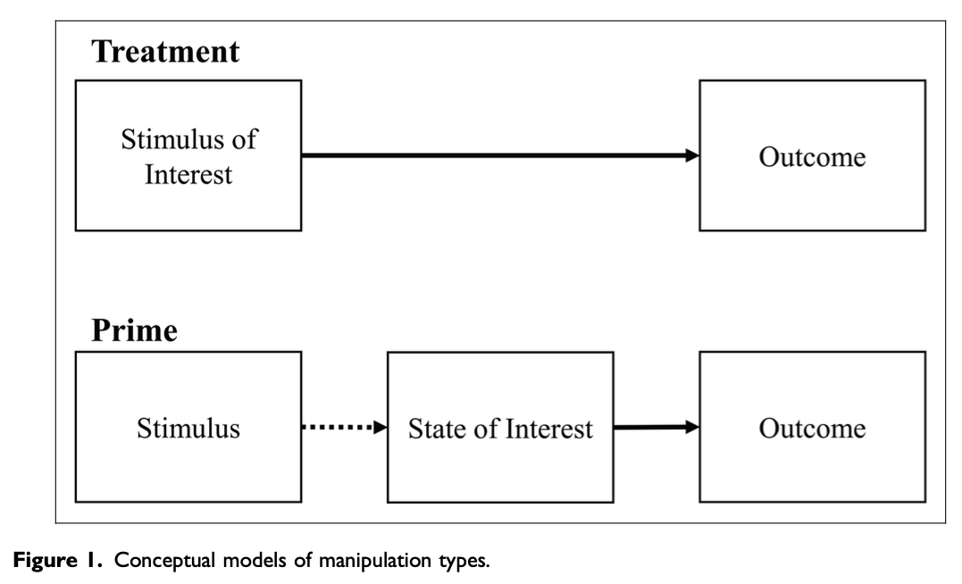
Experimental Manipulations Have Multiple Use Cases in Our Research
Treatments: Experimental designs exposing participants to different levels or types of a stimulus of theoretical interest
Imported from the natural sciences (e.g., RCTs), useful for isolating a phenomenon and providing a causal test of its effects
Primes: Experimental stimuli that are not of theoretical interest themselves, but generate variance in a state that is
Useful in social sciences to capture variance in cognitions, emotions, or other psychological states (particularly ones that are rare or hard to observe)
Schabram, et al., 2026

Slide 3
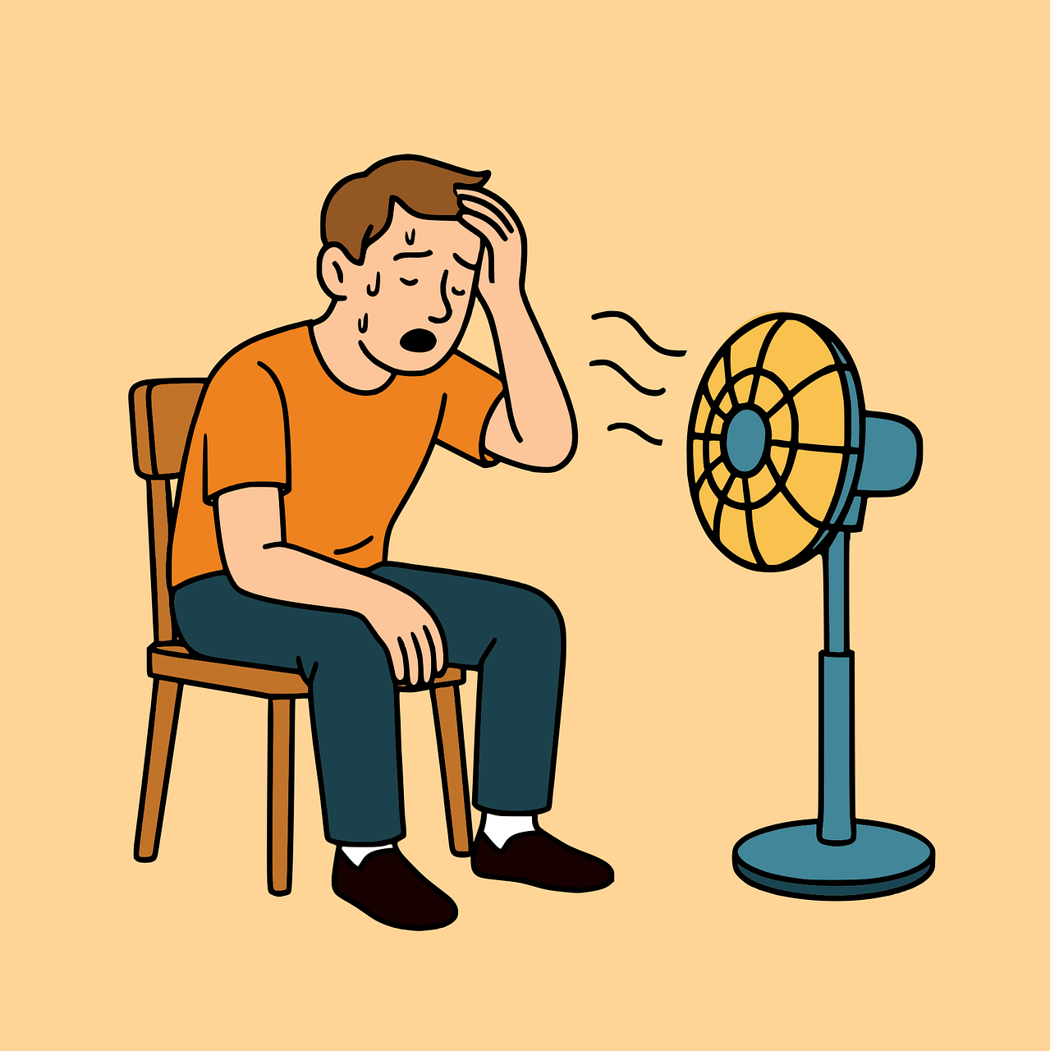

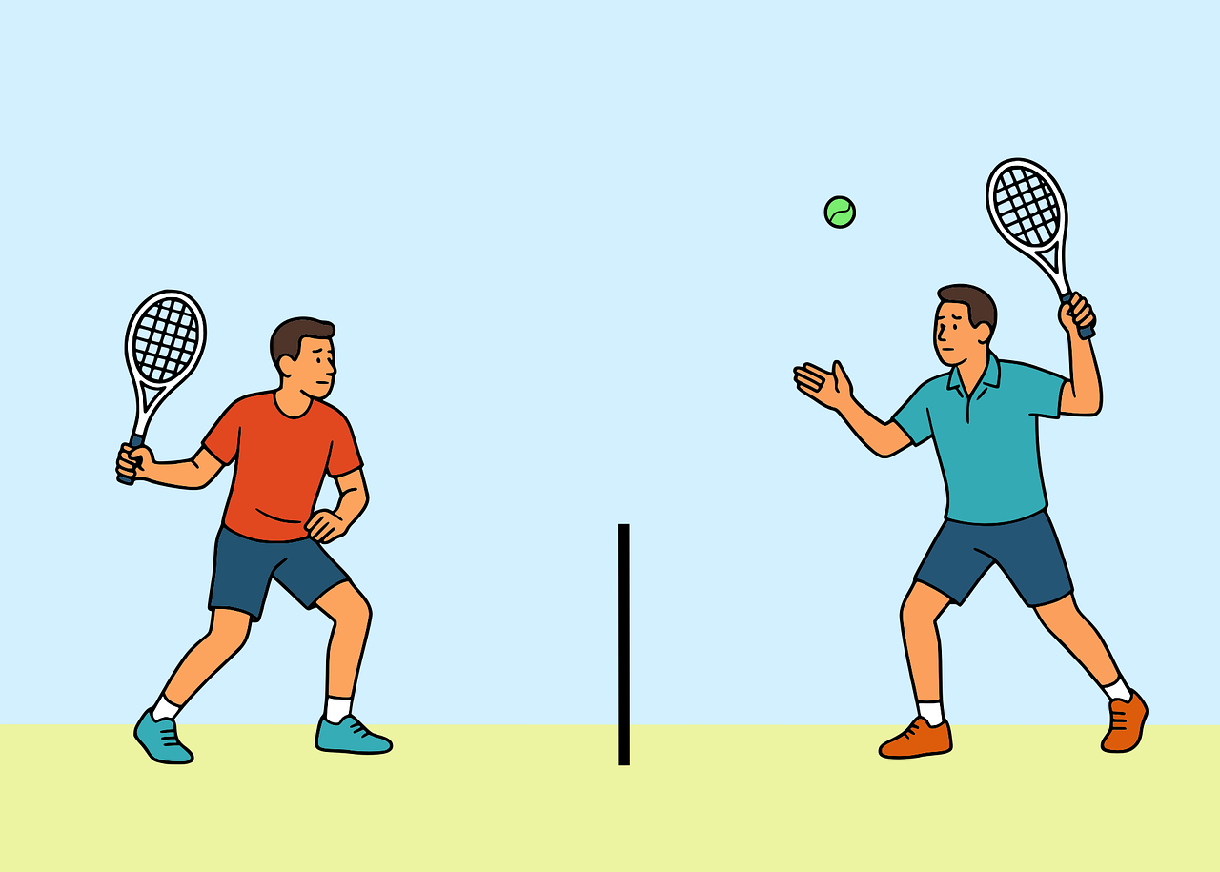

But We Don’t Always Recognize Them…
The readers of this study who are well versed in experimental methods will expect that your variable will be treated more like a manipulation check rather than a major variable in your analysis… If you don’t adhere to this convention commonly employed in experimental traditions, your paper might be viewed by that community as flawed or hiding null findings.
Our field often assumes all experimental manipulations are (or worse, should be) treatments, prioritizing causality over accuracy
You decided to use the measured scales of [state] rather than the manipulation code. I think it is better to use the manipulation as the IV… I will leave it to the editor [and] the other two reviewers on this matter, and encourage them to double check the analytical procedure.
Exhaustion
“Manipulation check”
Theorized Effect (but never tested!)
Control
Deviance
Exercise

Slide 4
So What Do We Do?
Inappropriate expectations that all manipulations should “work” as treatments results in mis-specified findings in our published studies (and likely contributes to file-drawer problem)
Our Assertion: A non-causal but accurate test of theory is superior to a causal but inaccurate test
Better to have the correlation of exhaustion and deviance than having a causal effect of exercise on deviance (and claiming it is an effect of exhaustion)
Treatments and primes (and their derivations, such as interventions or invariant prompts) have unique value to add to organizational research, but we must accurately describe, evaluate, and make sense of their results
No one use of manipulation is inherently “better” than another; all play a role within the broader methodological toolkit of organizational researchers

Slide 5
Best Practice Suggestions
A Priori Planning: Choose the appropriate manipulation to fit your research question at the outset
Incorporate appropriate design features (e.g., manipulation checks); avoid changing strategy in response to non-significant results
Contextualize and Complement: Consider each manipulation study in the context of the larger manuscript
Justify and explain when and why you deploy different designs and how they support/extend one another
Transparent Communication: Common nomenclature is crucial bridging language within our “big tent” field and across the sciences/practice divide
Name manipulations to ease interpretation, simplify methods write-ups, and facilitate meaningful extension; share as much of your data and design as possible

Slide 6
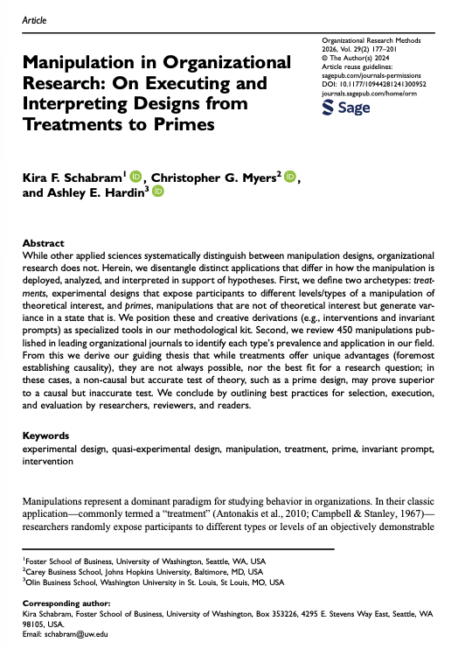
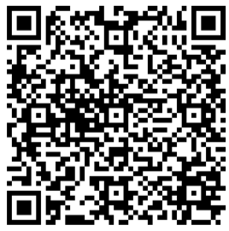
Thanks!
Reach out any time IF I CAN BE OF HELP!
Christopher G. Myers, PhD Peetz Family Professor of Leadership Johns Hopkins University Carey Business School
cmyers@jhu.edu christophergmyers.phd

