Slide 1

The EESOP Fables: Misconceptions About Endogeneity and Self-Organization in Social Network Research
Steve Borgatti
LINKS Center, Univ. of Kentucky
Many thanks to Vanessa Becker Bertoni for collecting all the ‘scriptures’ that I quote from
Notes:
This will be an anthropological talk, about belief s\ystems. Specifically, the belief systems of network researchers.
If you are fan of ergms, saoms or any of their family members, please don’t get defensive. This song is not about you. I am not discussing sgagtistical models .

Slide 2
Agenda
What: Describe a [postulated] emerging network belief system
I will refer to the inferred belief system as the Emergent Endogenous Self-Organizing Perspective (the EESOP*)
How: Hermeneutical inquiry
I will take excerpts from scriptures (the literature), and interpret them
Why: I will express some skepticism about these beliefs
*cf Aesop’s fables

Slide 3

Sample passage from scripture
"Self-organizing network effects are endogenous network effects that are inherent at all types of social networks … Self-organizing network effects are mechanisms or processes that are at play in a network. Self-organizing network effects are perceived as the micro-structures that explain the emergence of ties”
Notes:
Note keywords highlighted that have special meaning in this belief system

Slide 4
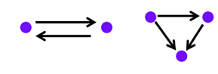


What are these “network effects”?
It is “clear” that these network effects are self-organizing, and endogenous, and inherent in all networks. But what are they?
Network statistics
Reciprocity
Transitivity
Cyclicity
Activity / popularity / preferential attachment
(sometimes) Homophily
$$\sum_{i,j}{x_{ij}x_{ji}}$$
$$\sum_{i,j,k}{x_{ij}x_{jk}x_{ik}}$$
Empirical regularities
Notes:
Measurements, quantify properties

Slide 5
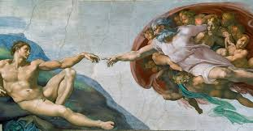
Endogeneity
Inherent and universal

Slide 6
Multiple legitimate uses of “endogenous”
Ordinary stats
An endogenous explanatory variable is one that is correlated with the error term
Exponential random graph models (ERGMs) – statistical usage
Endogenous terms model the dependence of each tie on other ties in the network. They account for non-independence of dyads
Dynamic processes
Variables whose values are not fixed but change over time due the changes in the other variables
Notes:
The clearest statement is from the snafun tutorial: "Exogenous and Endogenous terms: The first one refers to terms using covariates, the second to structural terms." Snanalyst That is a flat equation: exogenous = covariates, endogenous = structural.
The ScienceDirect ERGM overview makes the same move: "In ERG models, attributes are considered exogenous and network structural properties endogenous to the model." ScienceDirect
And from the Same but different paper: "Such models allow modeling the endogenous structural characteristics of a network simultaneously with the effect of exogenous variables (i.e., gender, age, socioeconomic status, etc.)."

Slide 7
In the EESOP*, additional meanings emerge
From scripture:
"Exogenous and Endogenous terms: The first one refers to terms using covariates, the second to structural terms.“
"In ERG models, attributes are considered exogenous and network structural properties endogenous to the model.“
"Such models allow modeling the endogenous structural characteristics of a network simultaneously with the effect of exogenous variables (i.e., gender, age, socioeconomic status, etc.).“
Endogenous terms are those that are purely structural – they can be computed from the network itself, without reference to characteristics of the node
*Emergent Endogenous Self-Organizing Perspective

Slide 8
Additional meaning in the EESOP
Scripture:
“The structural effects are inherent properties of [the] collaboration network and endogenous forces for the network evolution, because the [network being studied] is a complex and self-organizing network.”
“The theoretical contribution of this research is to suggest that government programs might catalyze cooperative activity by accelerating the preferential attachment mechanism inherent in social networks”
"Self-organizing network effects are endogenous network effects that are inherent at all types of social networks”
"Endogenous mechanisms suggest that networks are governed by their internal structural logic such as reciprocity (i.e., the proportion of mutual ties in a network) and transitivity (i.e., the proportion of transitive triads in a network).“
Endogenous means ‘inherent to networks’ or ‘baked-in’ or ‘due to the nature of networks’
*Emergent Endogenous Self-Organizing Perspective
Notes:
"Endogenous attributes refer to the idea that certain already-present network structures are responsible for ties looking the way they are."

Slide 9
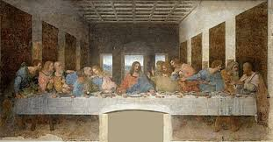
Mechanisms of tie formation
Empirical regularities viewed as causes

Slide 10
From scripture
"Tie-formation mechanisms like homophily, reciprocity, transitivity, and preferential attachment operate to varying degrees across contexts”
“Endogenously, reciprocity and transitivity play significant roles in tie formation”
“Other frequently explored mechanisms of tie-formation include reciprocity, preferential attachment”
“Self-organizing network effects are perceived as the micro-structures that explain the emergence of ties”
“We show that two structural characteristics, transitivity and mutuality, are significant predictors of the desire to form new ties”
Notes:
"reciprocation (the mechanism) is reduced to reciprocity (its outcome). A similar situation holds when transitivity (the mechanism) is reduced to path closure (its outcome).“ Lomi. Isn’t this saying that “reciprocity causes people to reciprocate ties”?
“…reciprocity, popularity, activity, location homophily, bank homophily and sales statistics constitute the common forces driving the formation of internal links.“
“Self-organizing network effects are perceived as the micro-structures that explain the emergence of ties”

Slide 11
Mechanisms of tie formation
Network effects are observed regularities, not causes
They are the explanandum, not the explanans
Reciprocity
Cultural norms
Psychological processes
Transitivity
Heider balance theory
Vetting and vouching
Opportunity for interaction
Homophily
Notes:
Mathematical mechanisms and social mechanisms

Slide 12
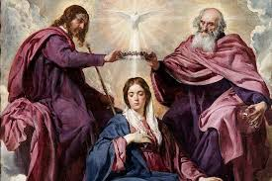
Self-organizing
Observed characteristics attributed to the network rather than actors

Slide 13
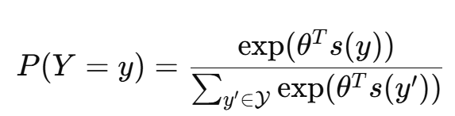
Modeling the joint probability of all ties
The ERGM models the probability of observing the entire network — the full pattern of who is tied to whom — as a function of a set of network statistics
Each statistic captures a tendency (e.g., toward reciprocity or transitivity) that makes certain tie configurations more or less probable
The resulting pattern of ties across the whole network is not specified by any single actor or rule or external force — in that sense, the global structure is emergent and (if you like) self-organizing
what is emergent is the observed structure, not the micro-tendencies that the model uses to predict it. Agent-based models, such as Schelling’s

Slide 14
In the EESOP it is the micro-level rules themselves that are emergent & self-organizing
Scripture:
“We also control for other self-organizing processes prevalent in networks, such as transitivity (i.e. the tendency for actors to form subgroups or triads where all three nodes are connected)”
"Self-organizing network effects are mechanisms or processes that are at play in a network. Self-organizing network effects are perceived as the micro-structures that explain the emergence of ties”
“Networks exhibit properties of self-organization, such as preferential attachment in which organizations tend to prefer well connected partners.”
"relatively limited attention has been given to the triad closure structures and two-path structures, which exhibit important self-organizing characteristics... these two structural patterns, respectively, reflect the logic of trust accumulation and the pathways of information transmission and are therefore critical for uncovering the endogenous mechanisms underlying venture capital networks formation.“
"the process in which the network forms a specific substructure through self-organization and then promotes the formation of other relationships within the network."

Slide 15


The mystic appeal of self-organization
Emergence. Self-organization. Autopoiesis. Autocatalysis.
Fractal self-similarity?
Phase transitions!
Chaos theory!
starling
A murmuration of starlings
Notes:
I know the pull of concepts like self-organization

Slide 16

Notes:
They can also organize themselves into Klingon bird of prey

Slide 17
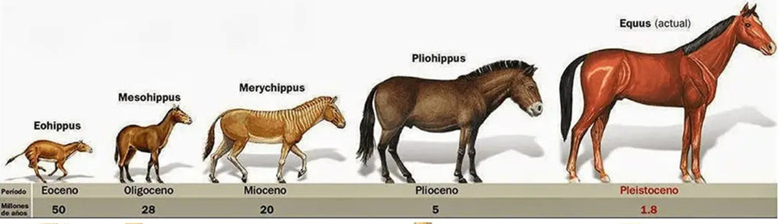
Orthogenesis
“RULE 5: THE NETWORK HAS A LIFE OF ITS OWN” – Christakis and Fowler
Focus on inherent properties and self-organization is reminiscent of orthogenesis/vitalism in biological evolution
ecosystems have their own evolutionary momentum separate from exogenous forces
G. Simpson disparaged this momentum as “mysterious inner force”
Similar to SAOM objective function that guides evolution of the net to its present observed equilibrium state
Notes:
Many have tried to expurgate orthogenesis from the modern synthesis
Belief system hangs around b/c of Baldwin effect & path dependency
Learned behaviors sometimes become hard-coded
Some evolutionary choices preclude other; Can only evolve in certain directions
Theprobabilities for a choice depend on the so-called objective function. This is a funcT.A.B. Snijders et al. / Social Networks 32 (2010) 44–60 47 tion of the network, as perceived by the focal actor. Informally, the objective function expresses how likely it is for the actor to change her/his networkinaparticular way.Onaverage,eachactor‘triesto’ moveintoadirectionofhighervaluesofher/his objective function, subject to the constraints of the current network structure and the changes made by the other actors in the network; and subject to random influences. The objective function will depend in practice on the personal network of the actor, as defined by the network betweenthefocal actor plus those to whomthereisadirect tie (or, depending on the specification, the focal actor plus those to whom there is a direct or indirect– i.e., distance-two– tie), including the covariates for all actors in this personal network. Thus, the probabilities of changesareassumedtodependonthepersonalnetworks thatwouldresultfromthechangesthatpossiblycouldbemade,and their composition in terms of covariates, via the objective function values of those networks.

Slide 18
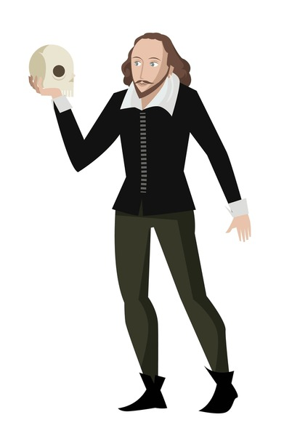
Sui Generis
Networks are entities, governed by own laws
“To be or not to be?” -- Hamlet

Slide 19
Networks as a thing in themselves
Scripture:
“Self-organizing network effects are endogenous network effects that are inherent at all types of social networks”
“The structural effects are inherent properties of [the] collaboration network”
Endogenous mechanisms suggest that networks are governed by their internal structural logic such as reciprocity
“Rule 5: the network has a life of its own”
“Amazingly simple and far-reaching natural laws govern the structure and evolution of all the complex networks that surround us,”
Significant literature on “network organizations”

Slide 20

Network organizations
Networks as midway between markets and hierarchies.
– 1990s literature
Notes:
Similar to keiretsu and chaebol

Slide 21
Networks as a thing of their own – cont.
Typically, networks seen as having some sort of advantage over other collective forms – an adaptation that has evolved over time
Miles & Snow. Flexible response to “dynamic and complex environments”
Podolny & Page. Managing high uncertainty and opportunism
Baker. Combine specialization with coordination
Nohria & Eccles. Lower cost of information exchange
Williamson. networks reduce transaction costs when asset specificity is high and trust can substitute for contracts
"It takes a network to defeat a network”
“This means that conflicts may increasingly be waged by networks, perhaps more than by hierarchies.”
Notes:
Standard model has 17 kinds of particles and 3 forces (kinds of ties) plus gravity. Electromagnetic force (mediated by photon)
Weak nuclear force (mediated by W and Z bosons)
Strong nuclear force (mediated by gluons)

Slide 22
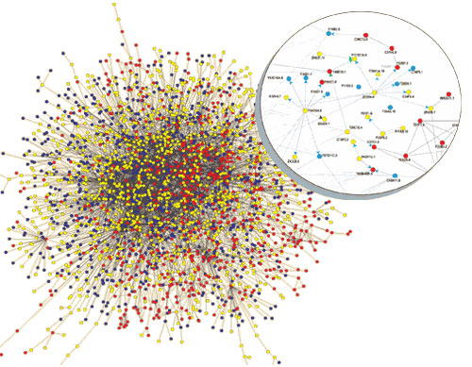
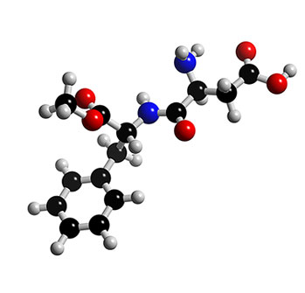
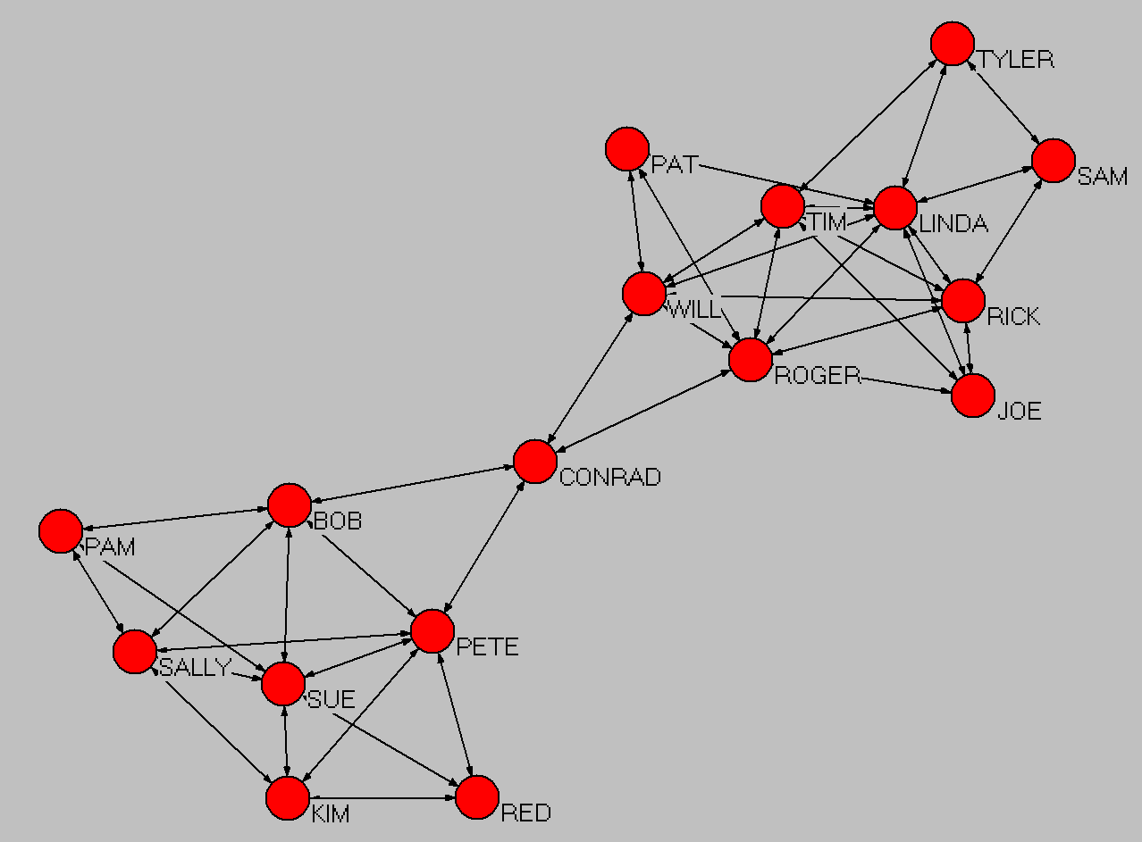
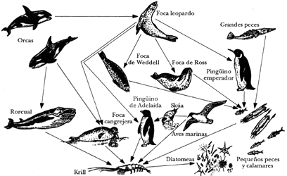
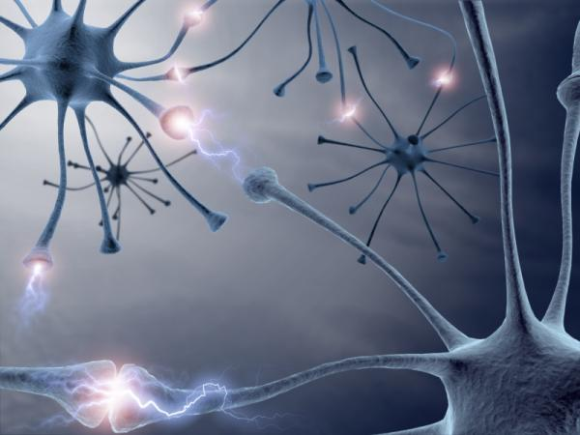
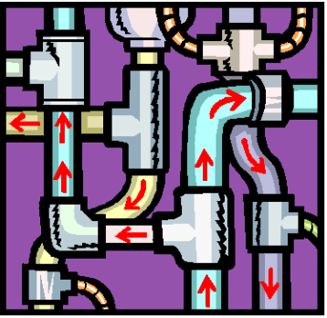
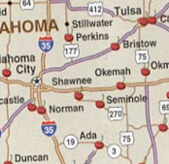
Networks as common solution of nature’s
Protein reactions
Org chart
Trust ties
Aspartame sweetener
WWW
Neurons in the brain
Food web
Notes:
I wonder if there are universal laws that govern all network phenomena?

Slide 23
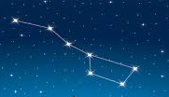
Are networks things?
Not as entities in themselves
It is a representation of the structure of a group
More of an adjective than a noun
It doesn’t exist apart from the nodes and ties (which *are* real)
Like personality
Networks are defined rather than found. Analytical devices
Every relational question on a survey generates a network
Look at this roster of names. Which are friends? Who is similar to you? Who is a leader? How often to you talk to each one?
Is a constellation a thing?

Slide 24
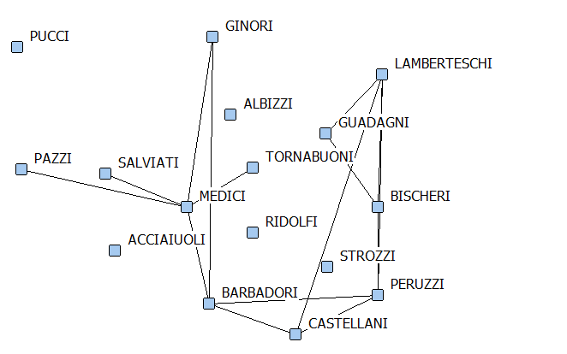
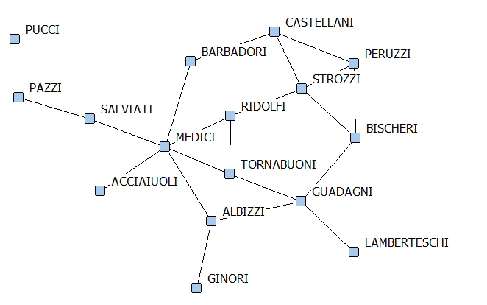
Dyadism and uniplexism
If networks are real, why are they all dyadic?
Why are our networks composed of only one kind of tie?
Advice, friendship, etc
Inventing multiplexity
Marriage Ties
Business Ties

Slide 25
I find myself in an odd place
I don’t think networks exist, but according to the EESOP, not only do they exist, but they have many unique properties
They’re built from self-organizing network effects that are endogenous and inherent and obey universal laws and their own internal structural logics
"Self-organizing network effects are endogenous network effects that are inherent at all types of social networks … Self-organizing network effects are mechanisms or processes that are at play in a network. Self-organizing network effects are perceived as the micro-structures that explain the emergence of ties”

Slide 26

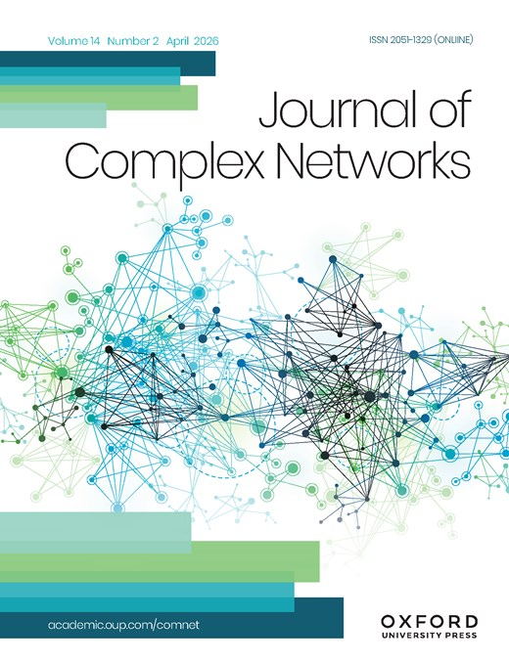
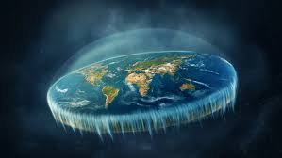

How we know what isn’t so*
Academics want to be cool
We readily adopt concepts we don’t understand
*With apologies to Thomas Gilovich
Notes:
Semantically a mirror to “the strength of weak ties”. In SOGI, Ron Burt coins the phrase “at risk of having good ideas”.
So what happens?

Slide 27

Extant
What management scholars think it means
Existing – “the extant literature on structural holes”
What the dictionary says it means
Surviving – “We present a revised classification for extant ferns..”
Are papers fighting for survival on Google Scholar?
Notes:
The phylogeny of the extant chelicerate orders

Slide 28
Conclusion
What’s wrong with you people?
Have an endogenous, emergent, self-organizing day!

Slide 29
Appendix

Slide 30

Semantically a mirror to “the strength of weak ties”. In SOGI, Ron Burt coins the phrase “at risk of having good ideas”.

Slide 31
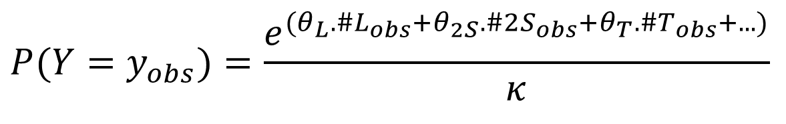
Tie formation
“Other frequently explored mechanisms of tie-formation include reciprocity, preferential attachment”
“Tie-formation mechanisms like homophily, reciprocity, transitivity, and preferential attachment operate to varying degrees across contexts.
“We show that two structural characteristics, transitivity and mutuality, are significant predictors of the desire to form new ties”
$$P(Y=y_{obs})=\frac{e^{(θ_{L}.\#L_{obs}+θ_{2S}.\#2S_{obs}+θ_{T}.\#T_{obs}+...)}}{κ}$$

