Slide 1
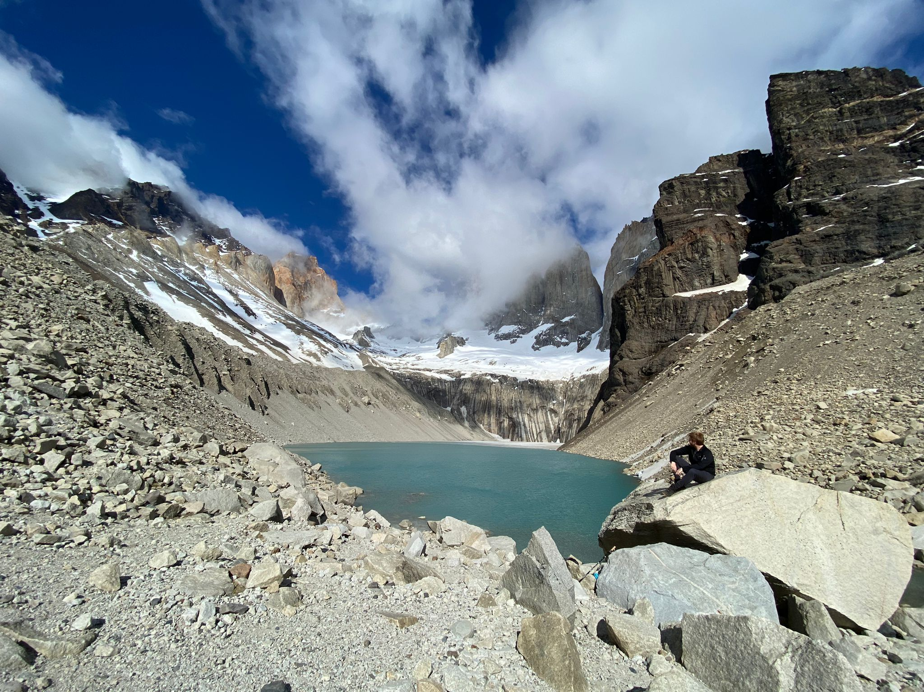
Prof. Dr. Anand van Zelderen
Assistant Professor in AI & Business
SKEMA Centre for AI (Paris)
Transformation Academy
Founder & Director of the Open Science ‘Openverse’ Initiative
Post-Doctoral Research Associate in Technology at Work – UZH
PhD – KU Leuven – Talent Management
BSc & MSc – Leiden University – (Social & Organizational) Psychology

Slide 2
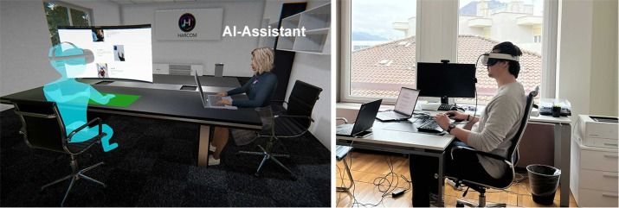
Virtual Reality Methodologies
Simulating Realistic Organizational Settings
+ Ecological validity
+ (Perfect) replicability
+ Attentive participants
- Novelty effects
- Participant interactions
- Time demanding
Van Zelderen, A. P., Masters-Waage, T. C., Dries, N., Menges, J. I., & Sanchez, D. R. (2025). Simulating virtual organizations for research: A comparative empirical evaluation of text-based, video, and virtual reality video vignettes. Organizational Research Methods, 28(3), 457-486.

Slide 3
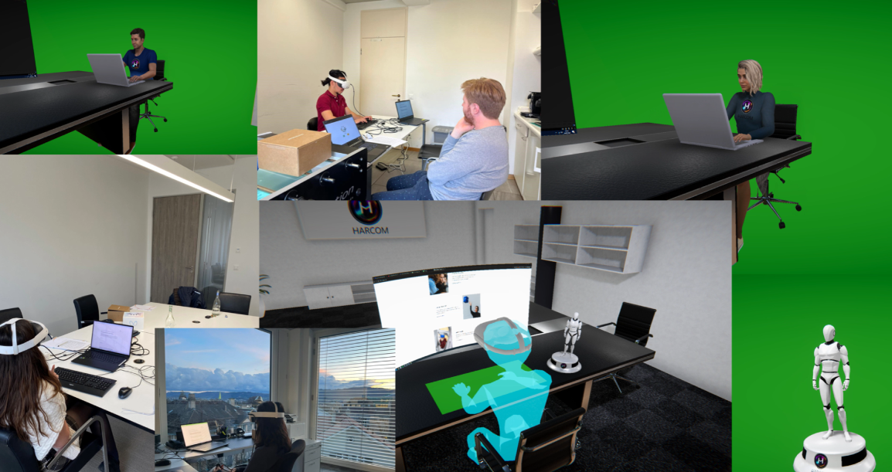
Recommendations for (Remote) Lab Research (Part 1)
Exploiting Technology-Powered Methods in the Field
1. Pick the right population
Employees for immersion/validity
Visit on location to ease data collection (i.e., mobile lab)
2. Plan your data collection
Make a schedule for sessions (maintain a reasonable buffer!)
3. Create a testing environment
Arrange a private, silent room
Eliminate all distractions (phones)
4. Get support with data collection
Assistants (MSc students?)
Notes:
Always ask to put phones silent/away

Slide 4
Recommendations for (Remote) Lab Research (Part 2)
Exploiting Technology-Powered Methods in the Field
5. Write an introduction script!!!
Standardize interactions with participants
6. Let participants acclimatize
The technology might be unfamiliar to them
+ Run a trial at home
Try and see if neighbour / sibling responds as expected
+ Anticipate technological issues
Bring backup laptop
Checklist for inventory

Slide 5
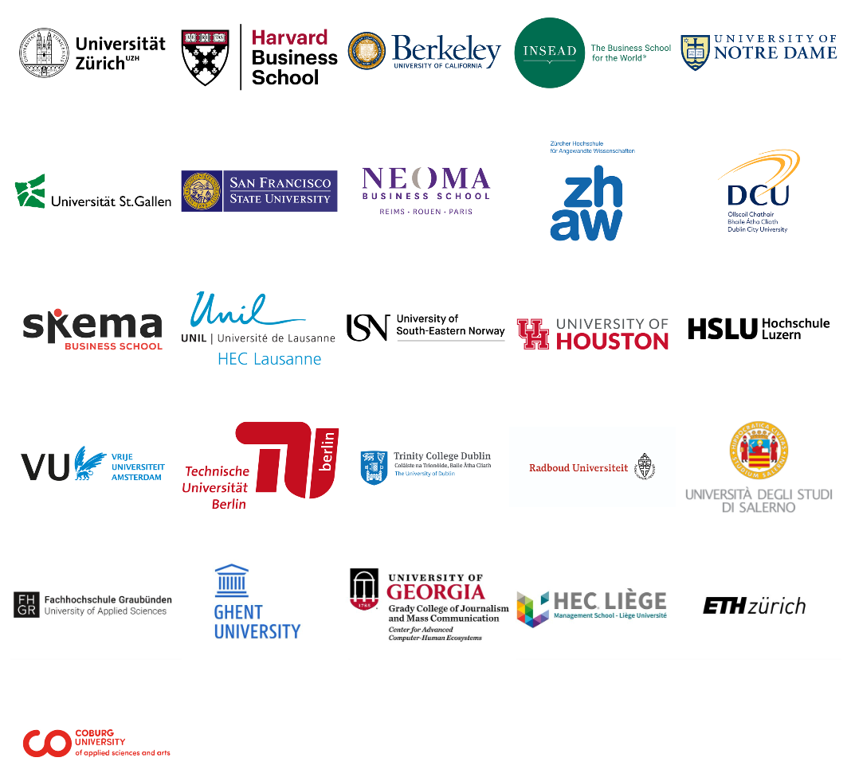

Openverse
Open Science Initiative: Open Research Data Sharing Protocols
Objective: Democratize access to cutting-edge immersive research tools, promote replicability in process. Resources: Fully customizable office-space with AI-powered avatars. (valued at ~ €335.000).
Price? Free. Return the favor (if you can!).
80+ Community members 35+ Institutions 16+ Countries
https://www.leadthefuture.org/openverse
van Zelderen, A. P. A., Masters-Waage, T. C., Affinito, S., Bekbergenova, A., Cowan, K., Hartmann, T., Hausfeld, M. M., Jolink, A., Korbel, J. J., Lynn, T., Reinier, L., Singh, D. P., Wu, S., Bosse, T., Derous, E., Kristen, F., Fritz, T., Gomez-Zara, D., Hauser, C., He, V., Howe, L. C., Jain, D., Kinias, Z., Lukic, Y. X., Menges, J. I., Mortezapour, A., Nagaraj, A., Park, C. H., Sanchez, D. R., Schellaert, M., Streuber, S., Viganò, E., Villano, M., Vleugels, W., Zank, M., & Hubbard, T. D. Creating common virtual ground: Protocols to democratize replicability in XR research. Science, (R&R-round 3).

Slide 6
INSERT OPENVERSE VIDEO (1m20s)

Slide 7
Questions?
anand.vanzelderen@skema.edu

